Slide 1
Chapter-4: Discrete Filter Structures
FIR Filter, Structures for FIR Filter:
Introduction:
For the design of digital filters, the system function H(z) or the impulse response h[n] must be specified. Then the digital filter structure can be implemented in hardware/software form by its difference equation obtained directly from H(z) or h[n].
To implement the specified difference equation of the system, the required basic operations are addition, delay and multiplication by a constant.
The structures are derived on the basis of computational complexity, ease of implementation of finite word length effect etc.

Slide 2
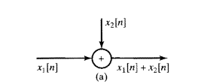

Block Diagram Representation:
When the system function H(z) or the impulse response h[n] is specified then the digital filters can be implemented or realized using block diagram. The following are the basic elements required for the implementation.
An adder:
It performs the addition of two signals.
A Constant Multiplier:
It multiplies a signal with a constant ‘a’.

Slide 3

A Unit Delay Element:
It delays the input sequence by one element.
Advantages of Representing the Digital System (i.e. Filters) in Block Diagram Form:
The computation algorithm can be easily written just by inspection.
The hardware requirement can be easily determined.
The relationship between input and output can be easily determined.
Canonic and Non-canonic Structures:
If the number of delays in the structure or realization block diagram is equal to the order of the difference equation or the order of the system function of a digital filter, then the structure is canonic otherwise non-canonic.

Slide 4
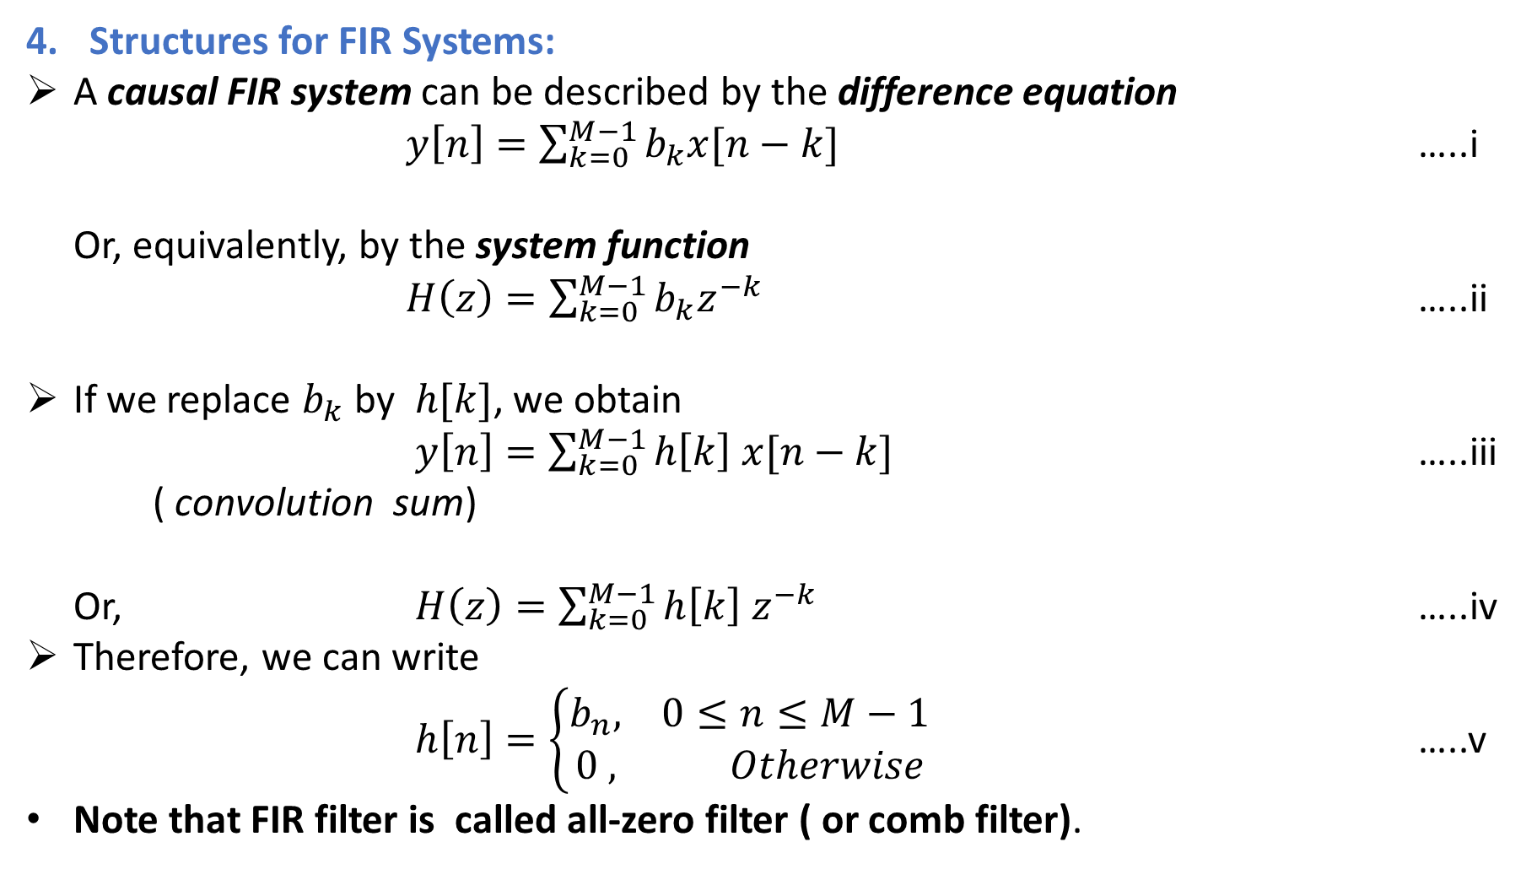
Structures for FIR Systems:
A causal FIR system can be described by the difference equation
$y\left[n\right]=\sum_{k=0}^{M−1}{b_{k}x[n−k]}$ …..i
Or, equivalently, by the system function
$H\left(z\right)=\sum_{k=0}^{M−1}{b_{k}z^{−k}}$ …..ii
If we replace $b_{k}$ by $h[k]$, we obtain
$y\left[n\right]=\sum_{k=0}^{M−1}{h\left[k\right] x[n−k]}$ …..iii
( convolution sum)
Or, $H\left(z\right)=\sum_{k=0}^{M−1}{h\left[k\right] z^{−k}}$ …..iv
Therefore, we can write
$h\left[n\right]=\left\{\begin{aligned}b_{n}, 0≤n≤M−1 \\ 0 , Otherwise\end{aligned}\right.$ …..v
Note that FIR filter is called all-zero filter ( or comb filter).

Slide 5
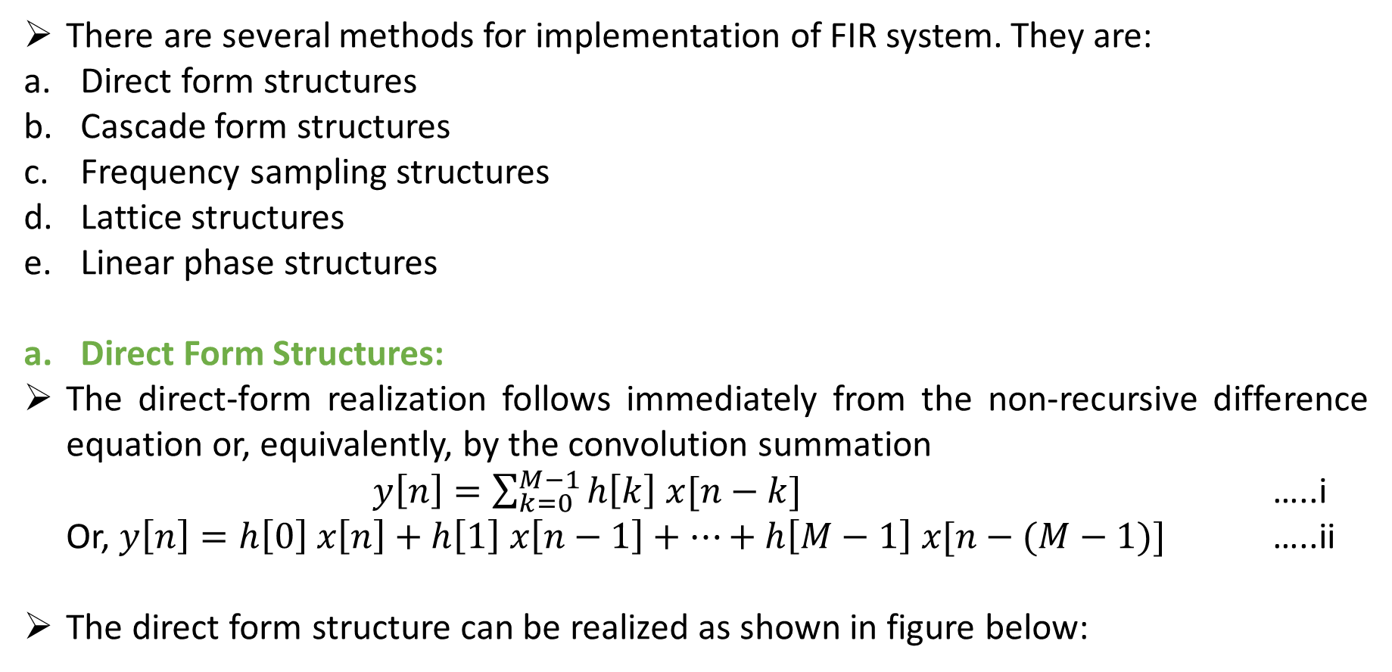
There are several methods for implementation of FIR system. They are:
Direct form structures
Cascade form structures
Frequency sampling structures
Lattice structures
Linear phase structures
Direct Form Structures:
The direct-form realization follows immediately from the non-recursive difference equation or, equivalently, by the convolution summation
$y\left[n\right]=\sum_{k=0}^{M−1}{h\left[k\right] x[n−k]}$ …..i
Or, $y\left[n\right]=h\left[0\right] x\left[n\right]+h\left[1\right] x\left[n−1\right]+…+h\left[M−1\right] x[n−(M−1)]$ …..ii
The direct form structure can be realized as shown in figure below:

Slide 6
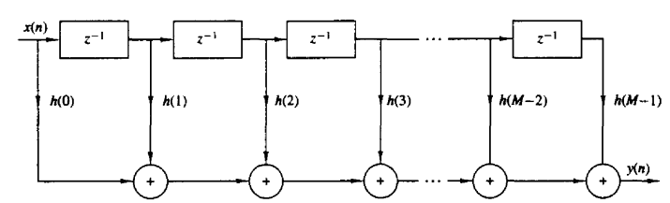
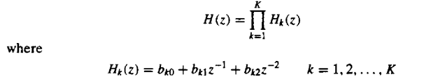
Because of the chain of delay elements across the top of the diagram, this structure is also referred to as a tapped delay line structure or a transversal filter structure.
Cascade Form Structures:
The cascade form structure of FIR system is obtained by factoring the polynomial system function as:

Slide 7
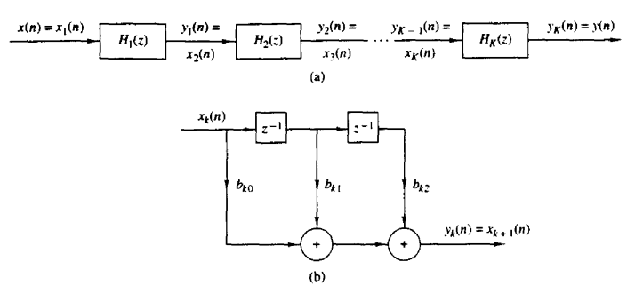

where, K= integer part of $\frac{M+1}{2}$.
If M is odd then K $=\frac{M+1}{2}$.
If M is even then K$=\frac{M}{2}$ with $b_{k2}=0$.
Fig: Cascade realization of an FIR system

Slide 8
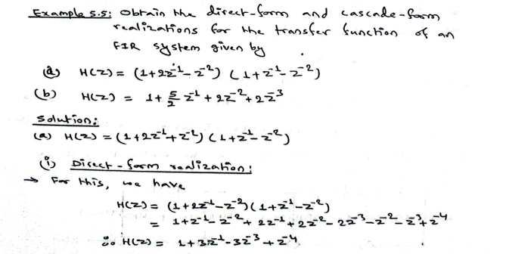

Slide 9
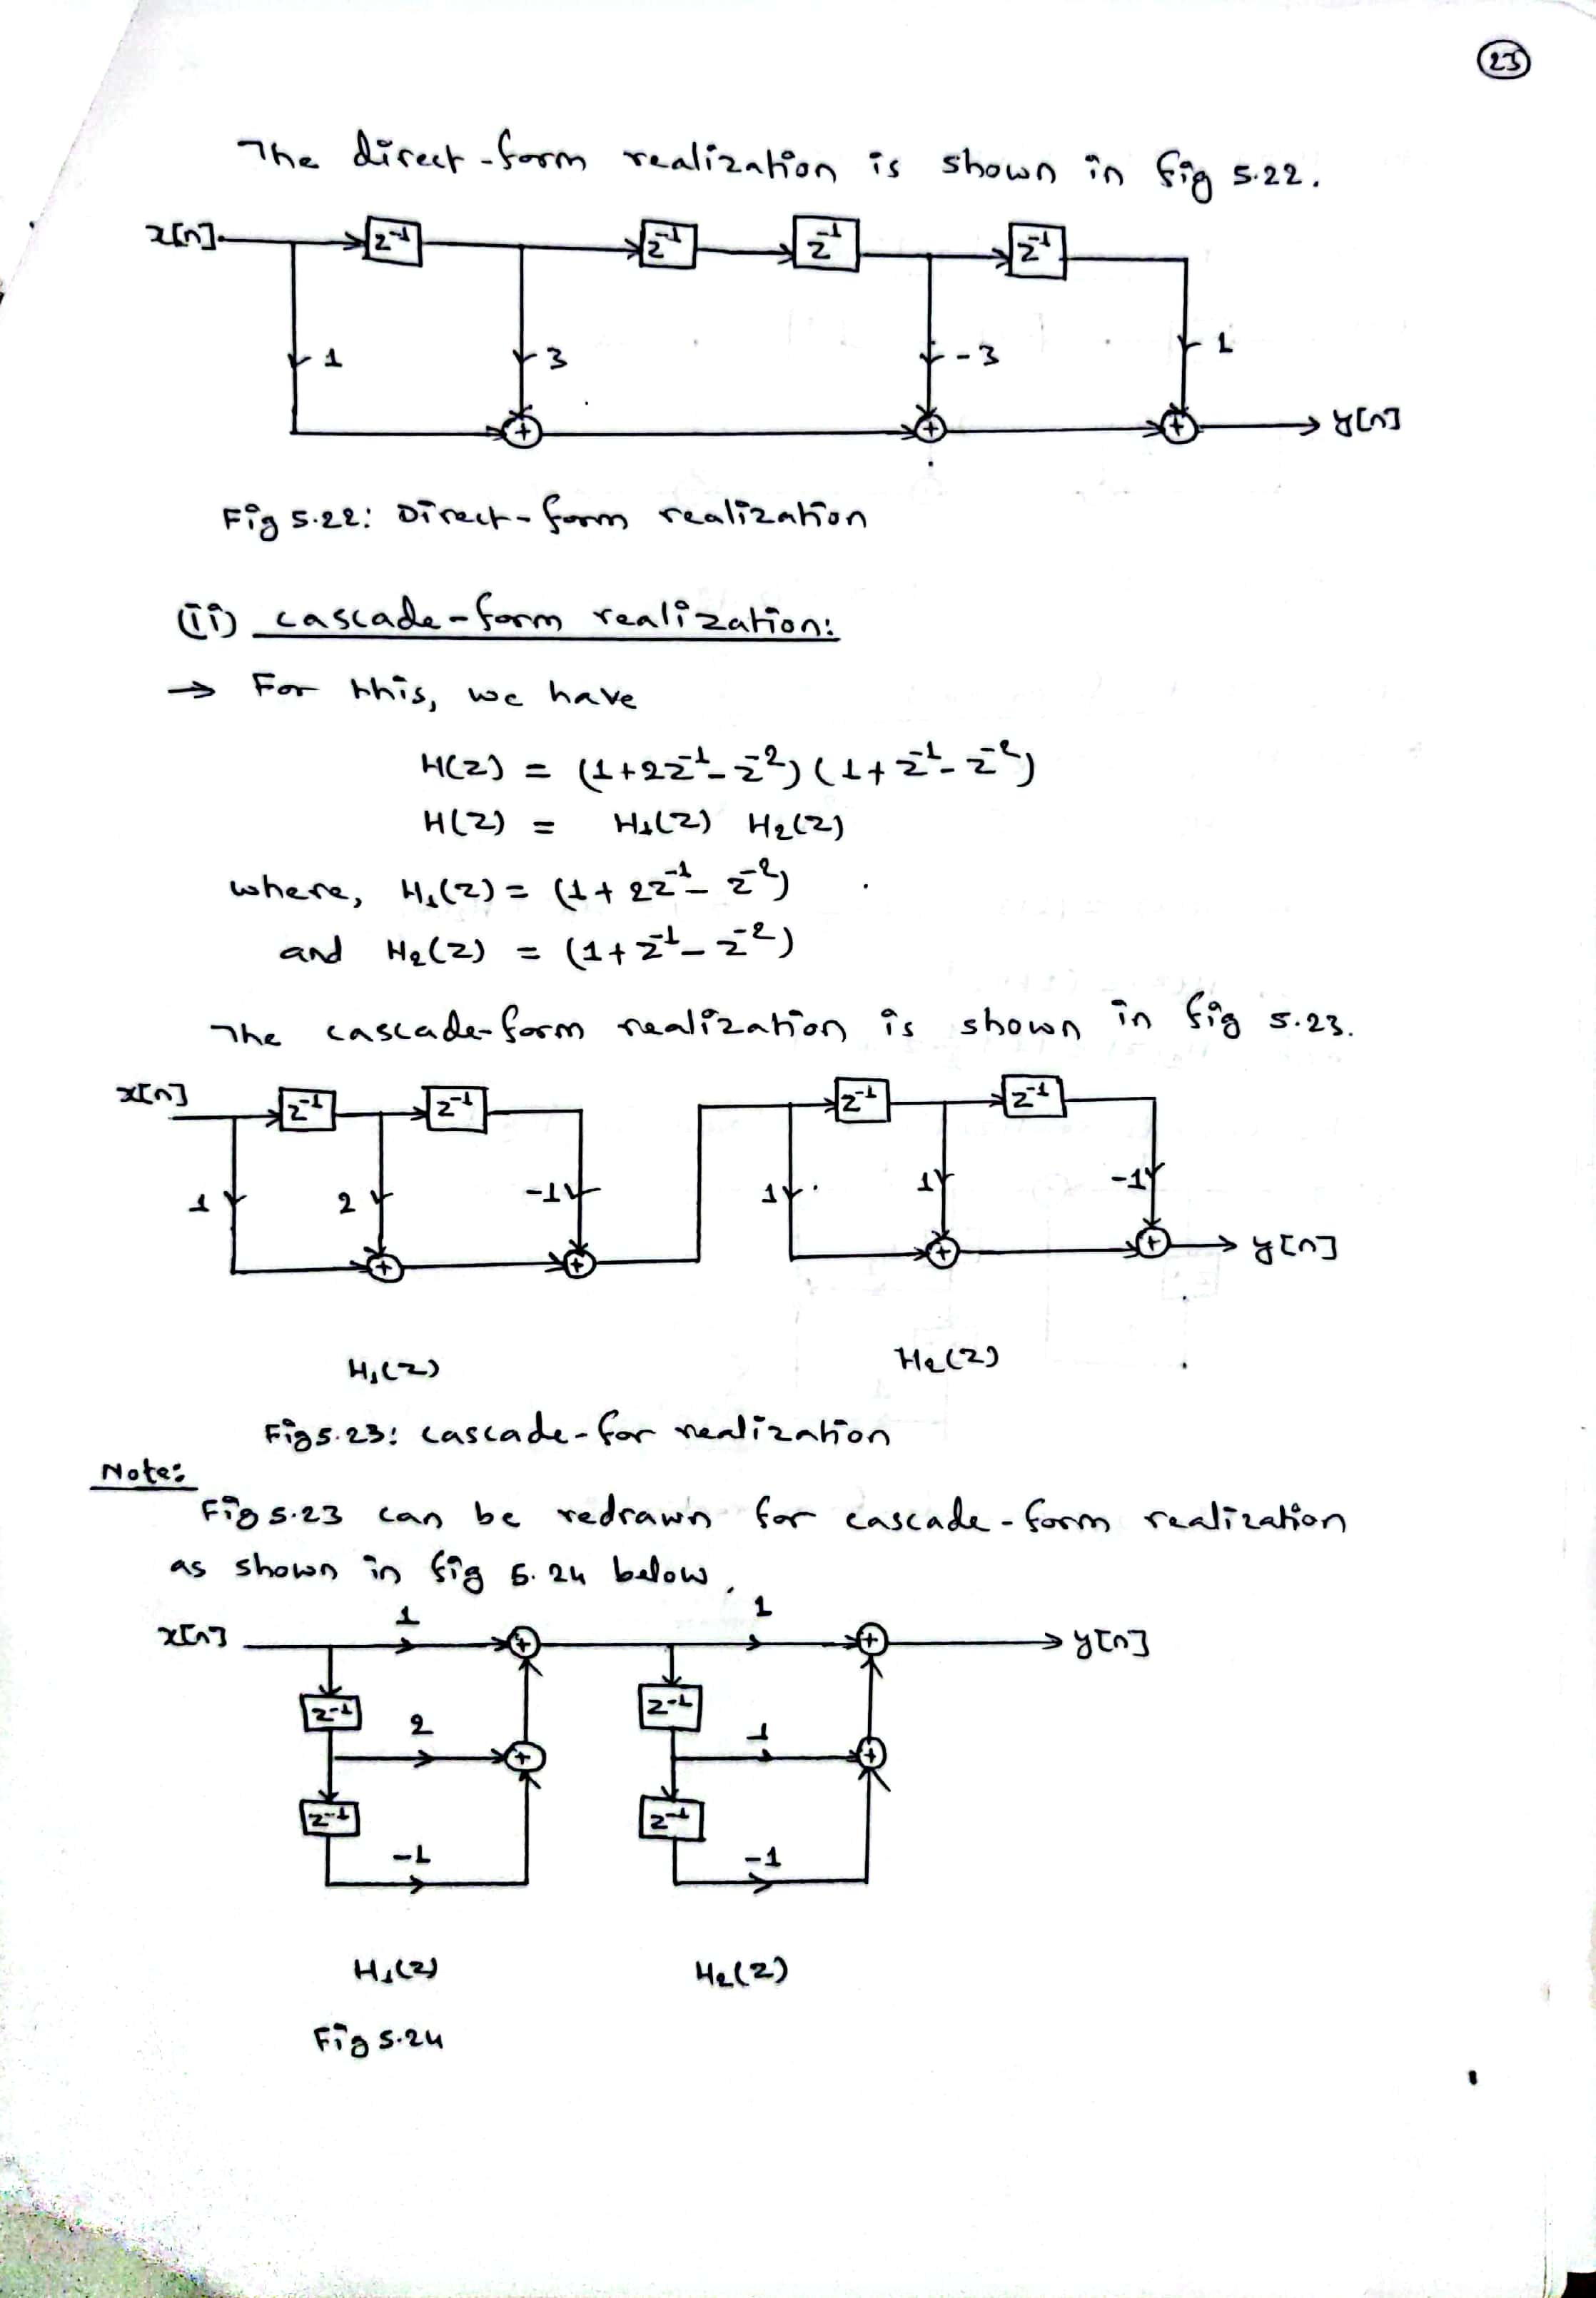

Slide 10
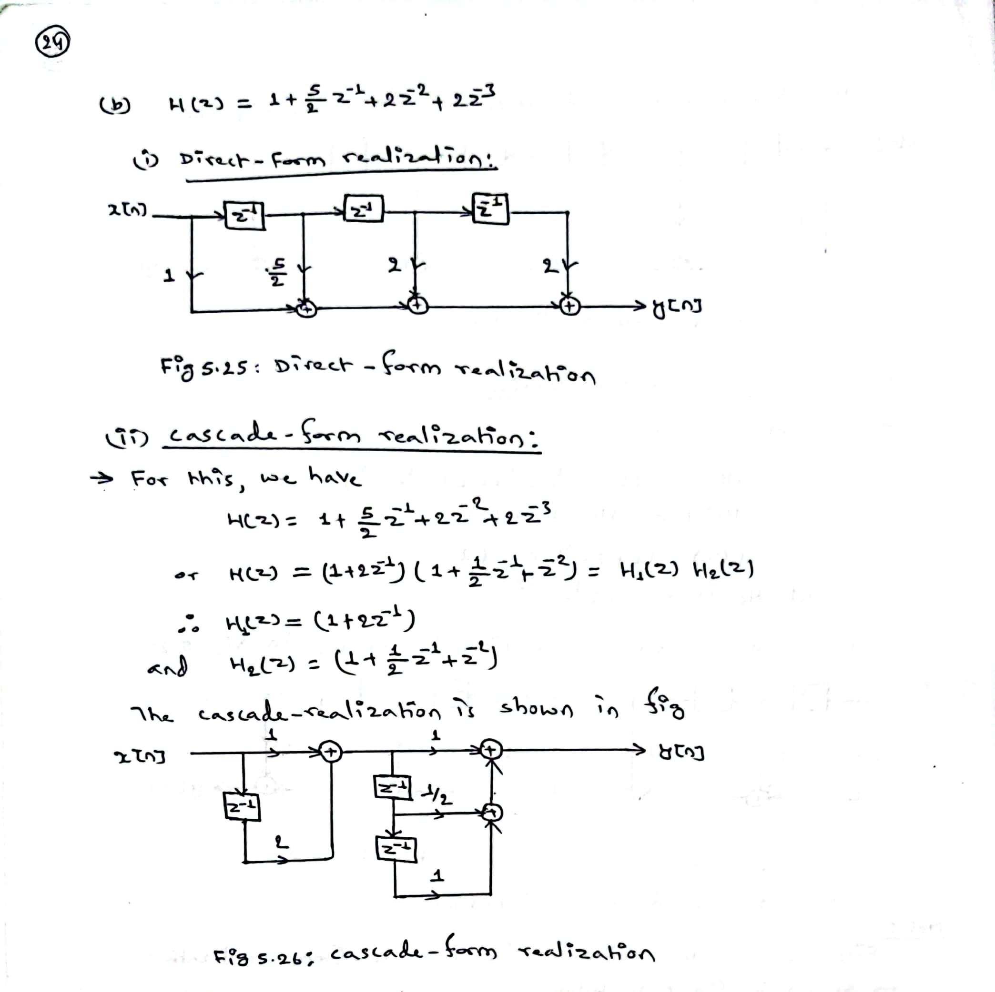

Slide 11
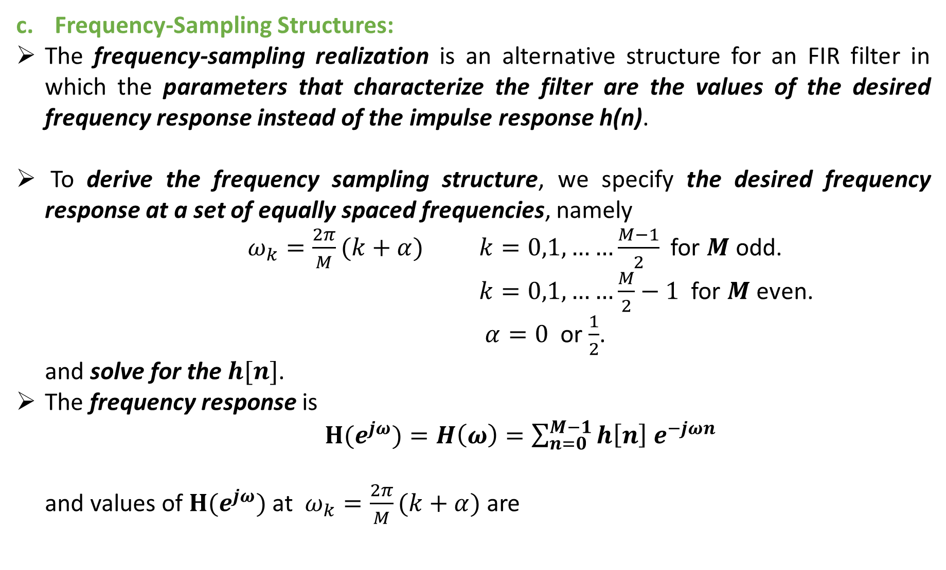
Frequency-Sampling Structures:
The frequency-sampling realization is an alternative structure for an FIR filter in which the parameters that characterize the filter are the values of the desired frequency response instead of the impulse response h(n).
To derive the frequency sampling structure, we specify the desired frequency response at a set of equally spaced frequencies, namely
$ω_{k}=\frac{2π}{M}(k+α)$ $k=0,1,……\frac{M−1}{2}$ for $M$ odd.
$k=0,1,……\frac{M}{2}−1$ for $M$ even.
$α=0$ or $\frac{1}{2}$.
and solve for the $h[n]$.
The frequency response is
$H(e^{jω})=H\left(ω\right)=\sum_{n=0}^{M−1}{h\left[n\right] e^{−jωn}}$
and values of $H(e^{jω})$ at $ω_{k}=\frac{2π}{M}(k+α)$ are

Slide 12
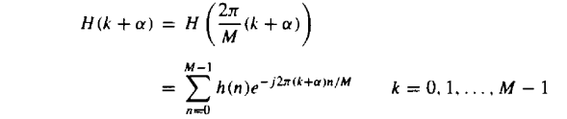

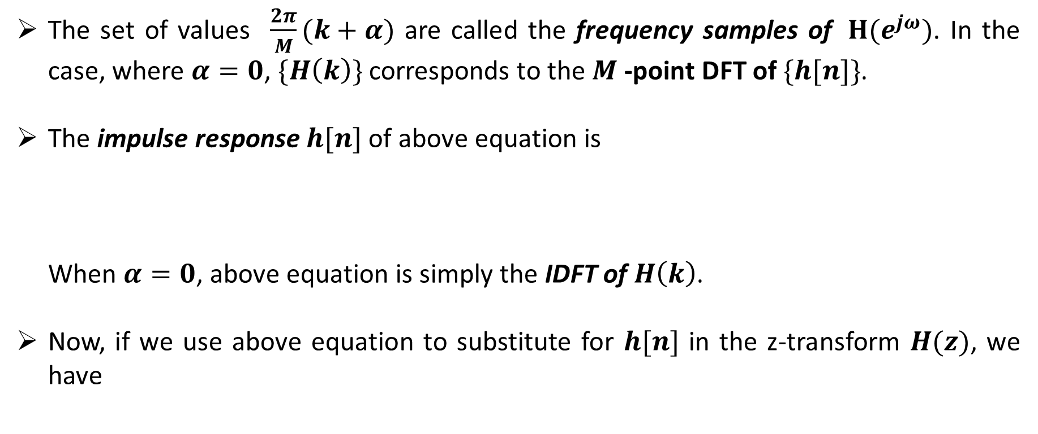
The set of values $\frac{2π}{M}(k+α)$ are called the frequency samples of $H(e^{jω})$. In the case, where $α=0$, $\{H\left(k\right)\}$ corresponds to the $M$ -point DFT of $\{h[n]\}$.
The impulse response $h[n]$ of above equation is
When $α=0$, above equation is simply the IDFT of $H\left(k\right)$.
Now, if we use above equation to substitute for $h[n]$ in the z-transform $H(z)$, we have

Slide 13
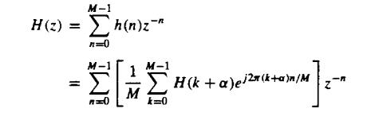
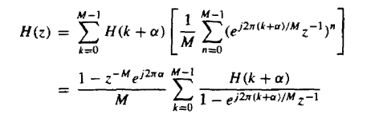
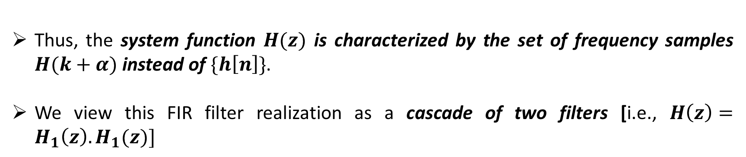
Thus, the system function $H(z)$ is characterized by the set of frequency samples $H(k+α)$ instead of $\{h\left[n\right]\}$.
We view this FIR filter realization as a cascade of two filters [i.e., $H\left(z\right)=H_{1}\left(z\right).H_{1}(z)]$

Slide 14
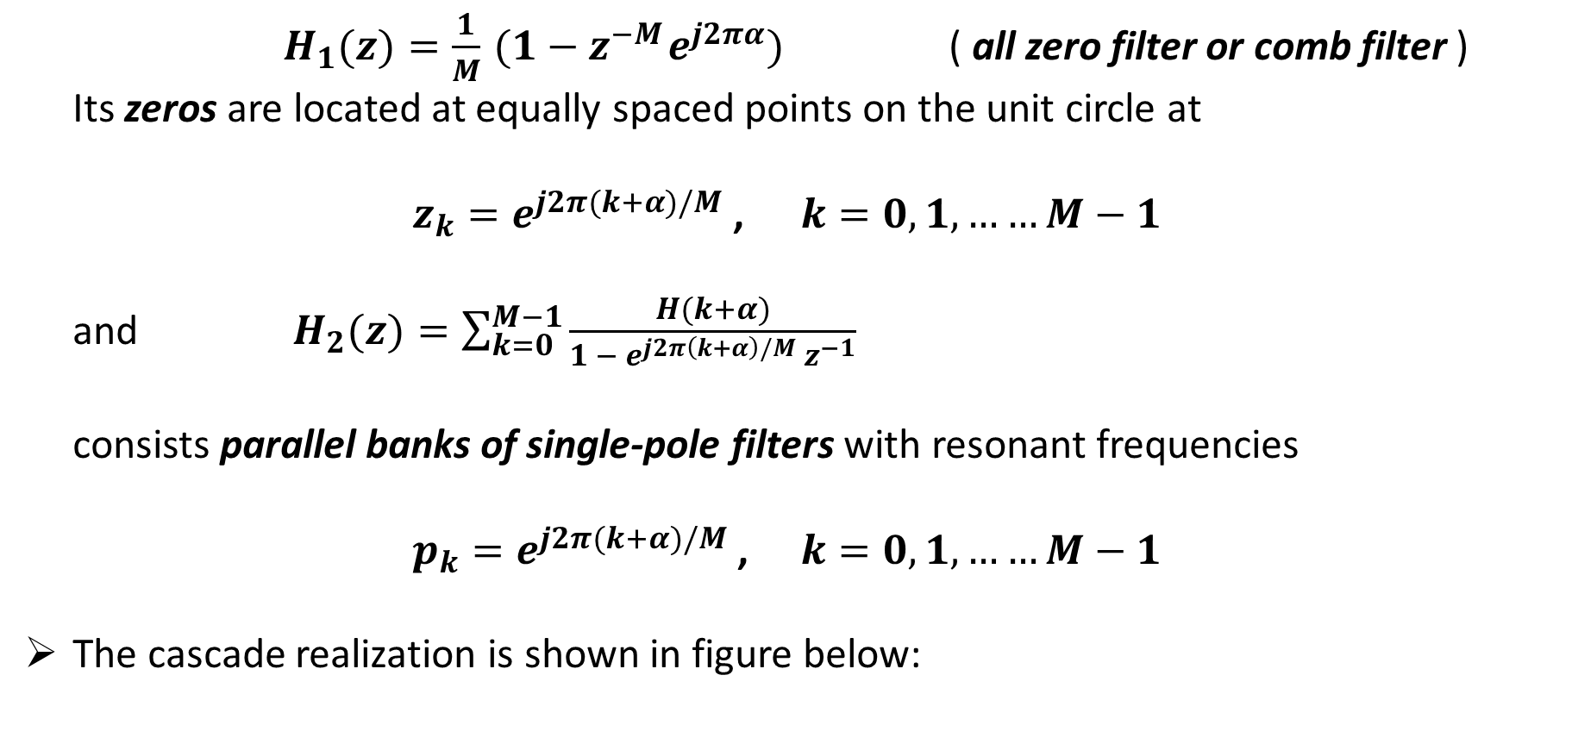
$H_{1}(z)=\frac{1}{M}{ (1−z}^{−M}e^{j2πα})$ ( all zero filter or comb filter )
Its zeros are located at equally spaced points on the unit circle at
$z_{k}=e^{j2π(k+α)/M}$ , $k=0,1,……M−1$
and $H_{2}(z)=\sum_{k=0}^{M−1}{\frac{H(k+α)}{1 − e^{j2π\left(k+α\right)/M}{ z}^{−1}}}$
consists parallel banks of single-pole filters with resonant frequencies
$p_{k}=e^{j2π(k+α)/M}$ , $k=0,1,……M−1$
The cascade realization is shown in figure below:

Slide 15
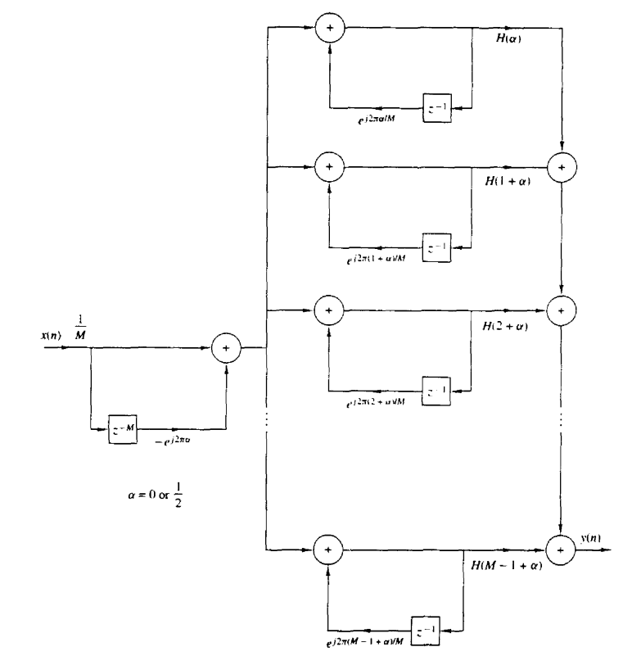

Slide 16
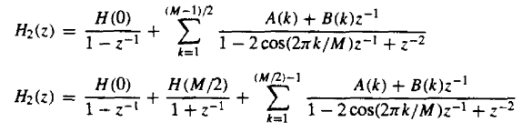

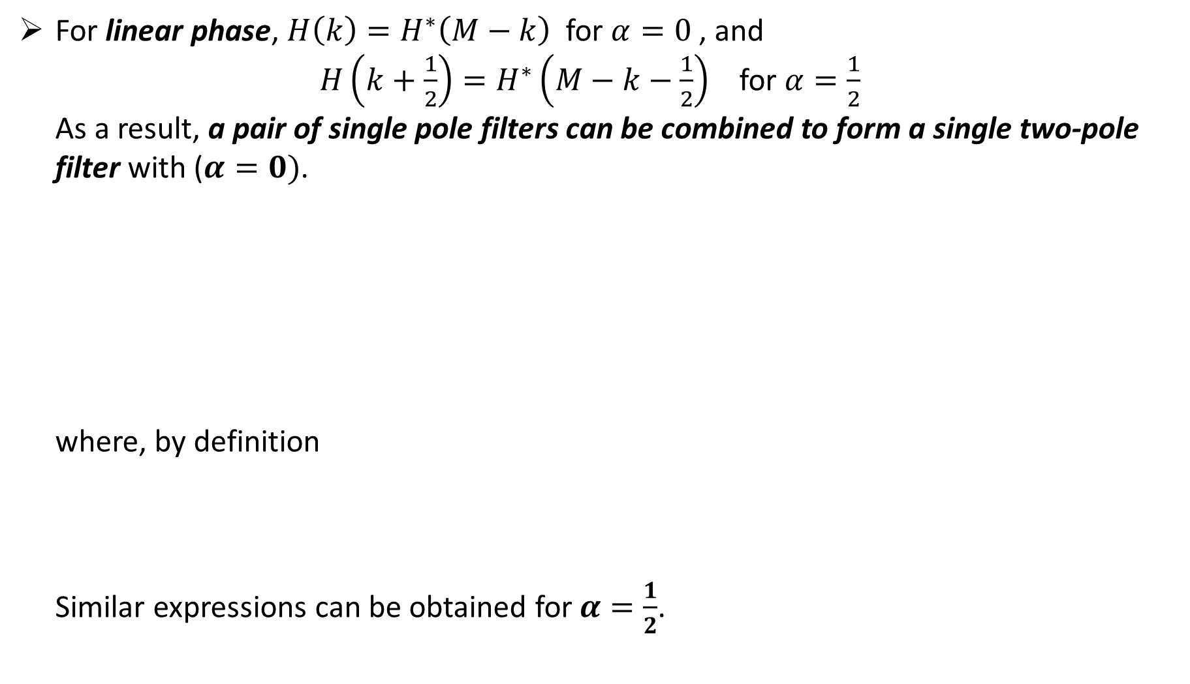
For linear phase, $H\left(k\right)=H^{∗}\left(M−k\right)$ for $α=0$ , and
$H\left(k+\frac{1}{2}\right)=H^{∗}\left(M−k−\frac{1}{2}\right)$ for $α=\frac{1}{2}$
As a result, a pair of single pole filters can be combined to form a single two-pole
filter with ($α=0)$.
where, by definition
Similar expressions can be obtained for$α=\frac{1}{2}$.

Slide 17
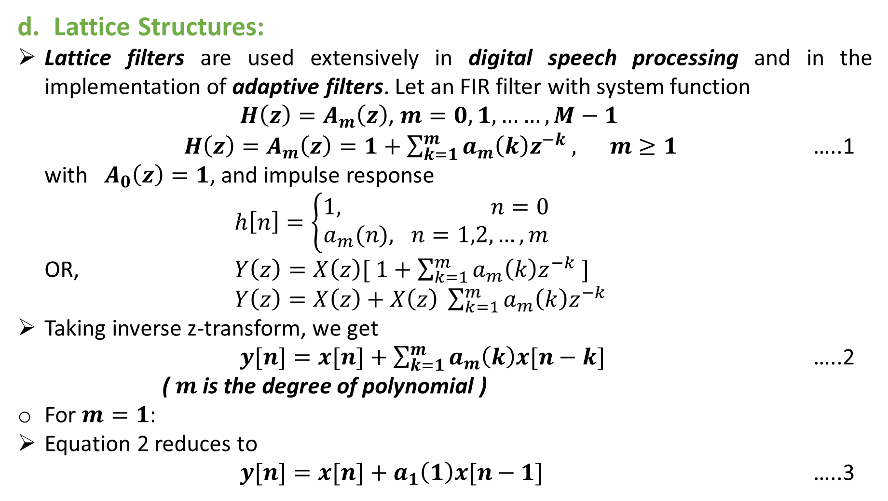
Lattice Structures:
Lattice filters are used extensively in digital speech processing and in the implementation of adaptive filters. Let an FIR filter with system function
$H\left(z\right)=A_{m}\left(z\right)$, $m=0,1,……,M−1$
$H\left(z\right)=A_{m}\left(z\right)=1+\sum_{k=1}^{m}{a_{m}\left(k\right)z^{−k} , m≥1}$ …..1
with $A_{0}\left(z\right)=1$, and impulse response
$h\left[n\right]=\left\{\begin{aligned}1, n=0 \\ a_{m}(n), n=1,2,…,m\end{aligned}\right.$
OR, $Y\left(z\right)=X\left(z\right)[ 1+\sum_{k=1}^{m}{a_{m}\left(k\right)z^{−k} ]}$
$Y\left(z\right)=X\left(z\right)+X\left(z\right) \sum_{k=1}^{m}{a_{m}\left(k\right)z^{−k} }$
Taking inverse z-transform, we get
$y[n]=x[n]+\sum_{k=1}^{m}{a_{m}\left(k\right)x[n−k] }$ …..2
( $m$ is the degree of polynomial )
For $m=1$:
Equation 2 reduces to
$y[n]=x[n]+a_{1}\left(1\right)x[n−1]$ …..3

Slide 18
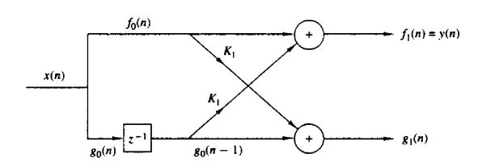

This single stage lattice filter can be realized as shown in figure below:
From above figure, we have
$x\left[n\right]=f_{0}\left[n\right]=g_{0}[n]$ …..4
$y\left[n\right]=f_{1}\left[n\right]=f_{0}\left[n\right]+k_{1 }g_{0}\left[n−1\right]=x\left[n\right]+k_{1}x\left[n−1\right]$ …..5
$g_{1}\left[n\right]=k_{1}f_{0}\left[n\right]+g_{0}\left[n−1\right]=k_{1}x\left[n\right]+x\left[n−1\right]$ …..6

Slide 19
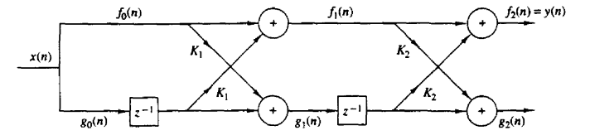
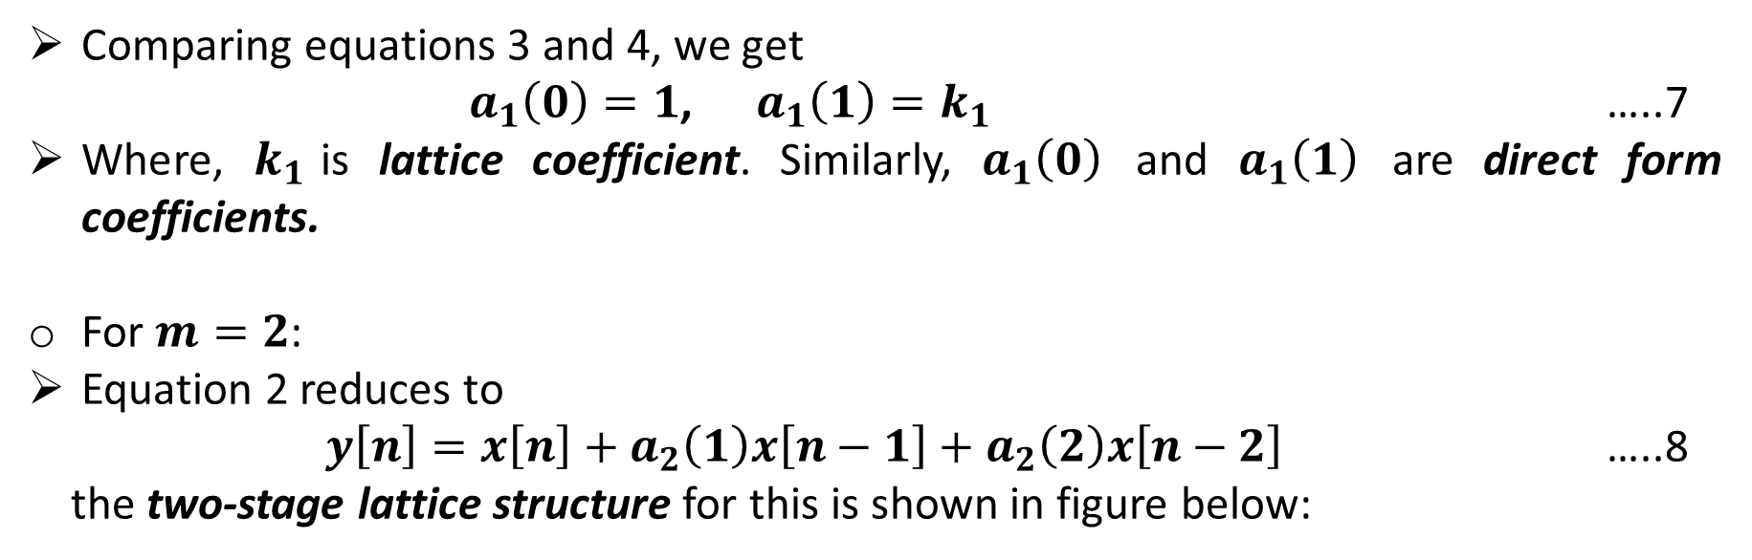
Comparing equations 3 and 4, we get
$a_{1}\left(0\right)=1$, $a_{1}\left(1\right)=k_{1}$ …..7
Where, $k_{1}$is lattice coefficient. Similarly, $a_{1}\left(0\right)$ and $a_{1}\left(1\right)$ are direct form coefficients.
For $m=2$:
Equation 2 reduces to
$y\left[n\right]=x\left[n\right]+a_{2}\left(1\right)x\left[n−1\right]+a_{2}\left(2\right)x\left[n−2\right]$ …..8
the two-stage lattice structure for this is shown in figure below:

Slide 20
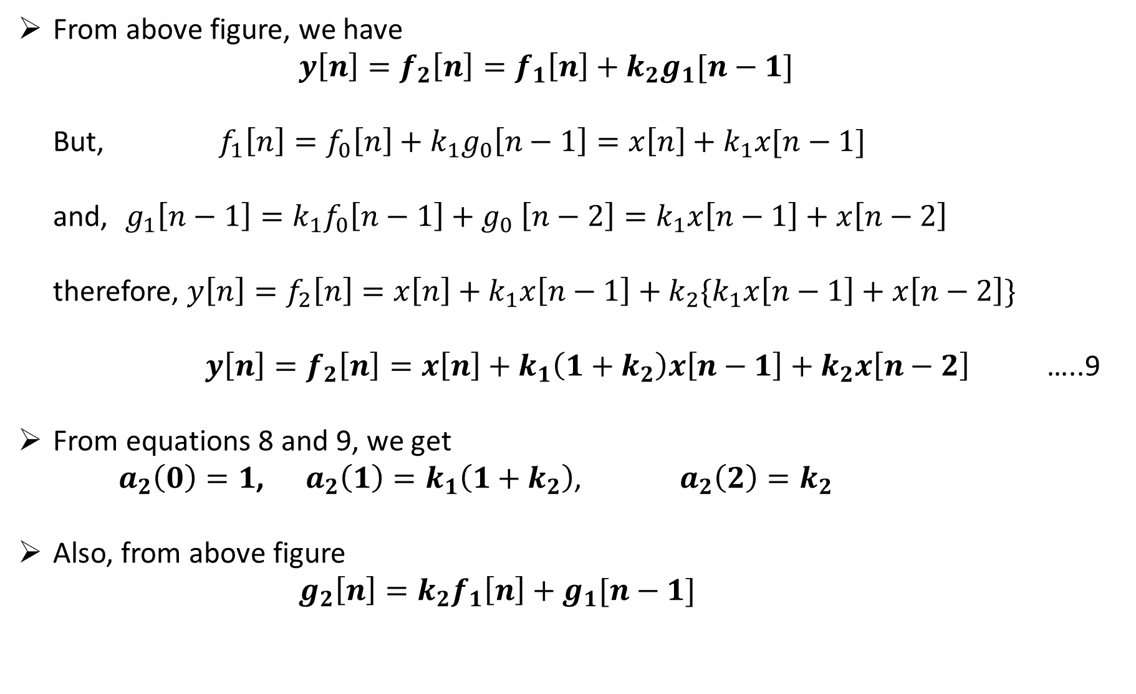
From above figure, we have
$y\left[n\right]=f_{2}\left[n\right]=f_{1}\left[n\right]+k_{2}g_{1}[n−1]$
But, $f_{1}\left[n\right]=f_{0}\left[n\right]+k_{1}g_{0}\left[n−1\right]=x\left[n\right]+k_{1}x[n−1]$
and, $g_{1}\left[n−1\right]=k_{1}f_{0}\left[n−1\right]+g_{0} \left[n−2\right]=k_{1}x\left[n−1\right]+x\left[n−2\right]$
therefore, $y\left[n\right]=f_{2}\left[n\right]=x\left[n\right]+k_{1}x\left[n−1\right]+k_{2}\{k_{1}x\left[n−1\right]+x\left[n−2\right]\}$
$y\left[n\right]=f_{2}\left[n\right]=x\left[n\right]+k_{1}\left(1+k_{2}\right)x\left[n−1\right]+k_{2}x\left[n−2\right]$ …..9
From equations 8 and 9, we get
$a_{2}\left(0\right)=1$, $a_{2}\left(1\right)=k_{1}\left(1+k_{2}\right)$, $a_{2}\left(2\right)=k_{2}$
Also, from above figure
$g_{2}\left[n\right]=k_{2}f_{1}\left[n\right]+g_{1}[n−1]$

Slide 21
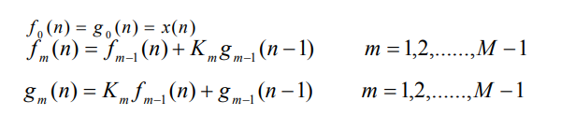
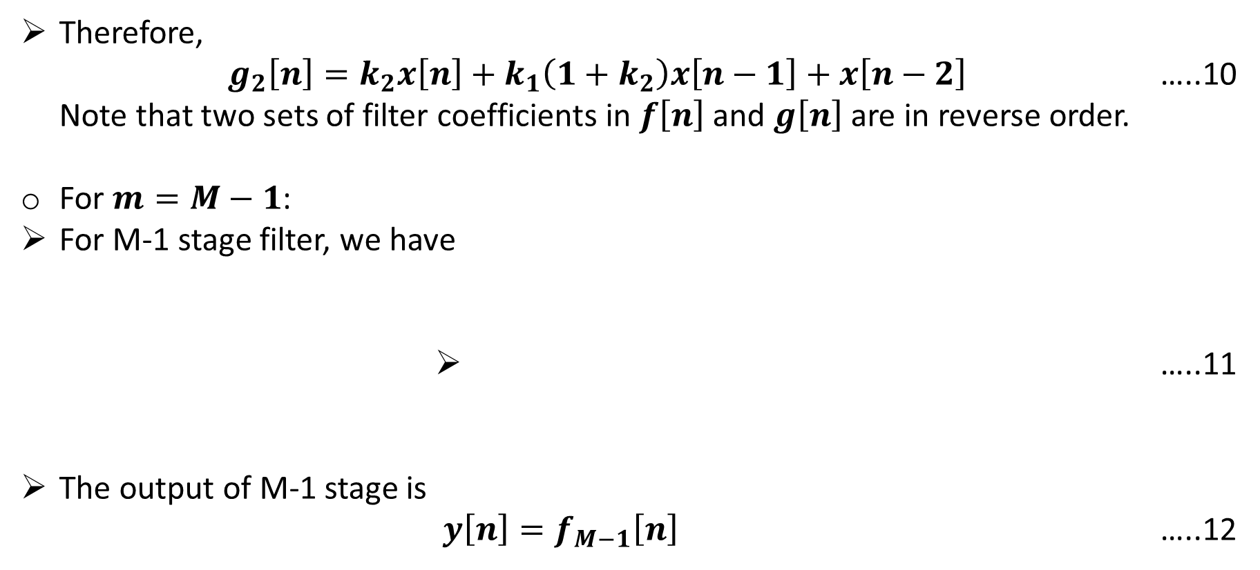
Therefore,
$g_{2}\left[n\right]=k_{2}x\left[n\right]+k_{1}\left(1+k_{2}\right)x\left[n−1\right]+x\left[n−2\right]$ …..10
Note that two sets of filter coefficients in $f\left[n\right]$ and $g\left[n\right]$ are in reverse order.
For $m=M−1$:
For M-1 stage filter, we have
…..11
The output of M-1 stage is
$y\left[n\right]=f_{M−1}\left[n\right]$ …..12

Slide 22
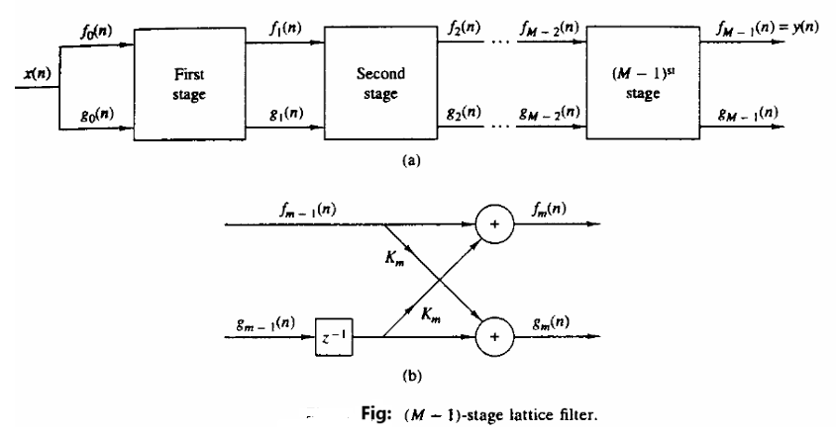
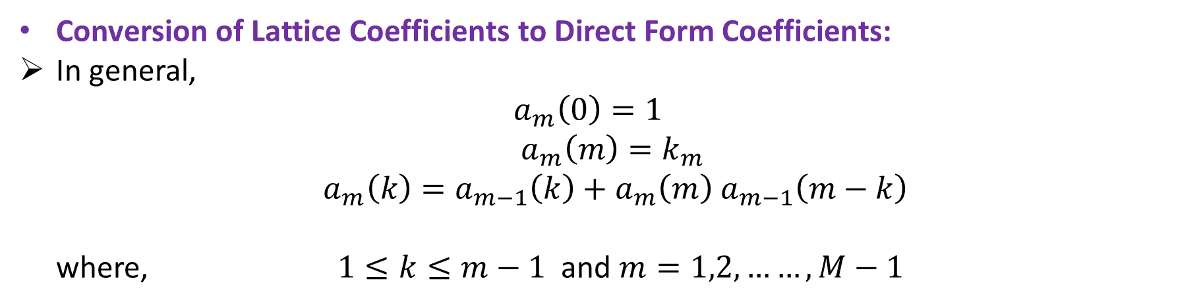
Conversion of Lattice Coefficients to Direct Form Coefficients:
In general,
$a_{m}\left(0\right)=1$
$a_{m}\left(m\right)=k_{m}$
$a_{m}\left(k\right)=a_{m−1}\left(k\right)+a_{m}\left(m\right)$ $a_{m−1}\left(m−k\right)$
where, $1≤k≤m−1$ and $m=1,2,……,M−1$

Slide 23
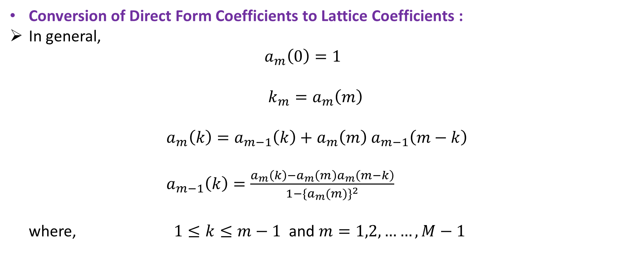
Conversion of Direct Form Coefficients to Lattice Coefficients :
In general,
$a_{m}\left(0\right)=1$
$k_{m}=a_{m}\left(m\right)$
$a_{m}\left(k\right)=a_{m−1}\left(k\right)+a_{m}\left(m\right)$ $a_{m−1}\left(m−k\right)$
$a_{m−1}\left(k\right)=\frac{a_{m}\left(k\right)−a_{m}\left(m\right)a_{m}\left(m−k\right)}{1−{{\{a}_{m}(m)\}}^{2}}$
where, $1≤k≤m−1$ and $m=1,2,……,M−1$

Slide 24
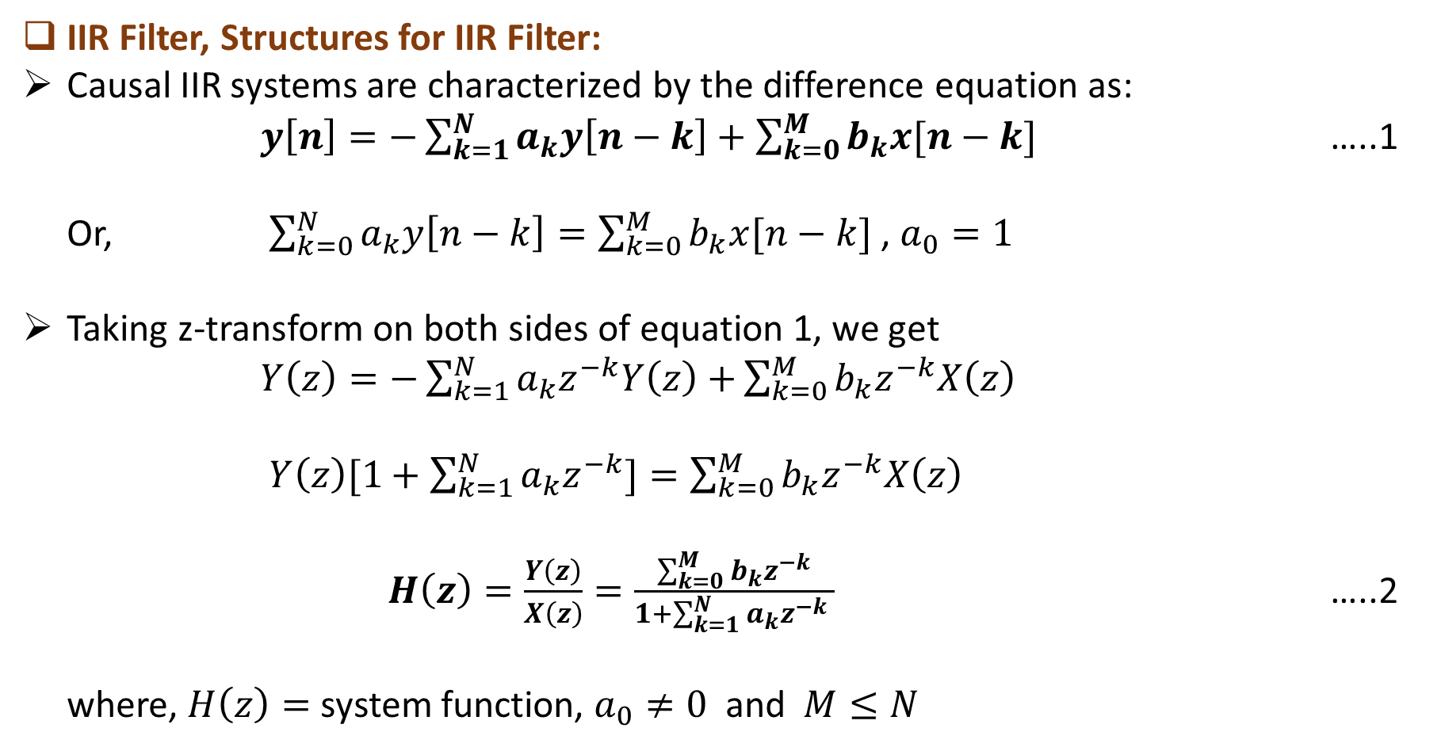
IIR Filter, Structures for IIR Filter:
Causal IIR systems are characterized by the difference equation as:
$y\left[n\right]=−\sum_{k=1}^{N}{a_{k}y\left[n−k\right]+\sum_{k=0}^{M}{b_{k}x[n−k]}}$ …..1
Or, $\sum_{k=0}^{N}{a_{k}y\left[n−k\right]=\sum_{k=0}^{M}{b_{k}x[n−k]}}$ , $a_{0}=1$
Taking z-transform on both sides of equation 1, we get
$Y\left(z\right)=−\sum_{k=1}^{N}{a_{k}z^{−k}Y\left(z\right)+}\sum_{k=0}^{M}{b_{k}z^{−k}X\left(z\right)}$
$Y\left(z\right)[1+\sum_{k=1}^{N}{a_{k}z^{−k}]=\sum_{k=0}^{M}{b_{k}z^{−k}X\left(z\right)}}$
$H\left(z\right)=\frac{Y\left(z\right)}{X\left(z\right)}=\frac{\sum_{k=0}^{M}{b_{k}z^{−k}}}{1+\sum_{k=1}^{N}{a_{k}z^{−k} }}$ …..2
where, $H\left(z\right)=$ system function, $a_{0}≠0$ and$M≤N$

Slide 25
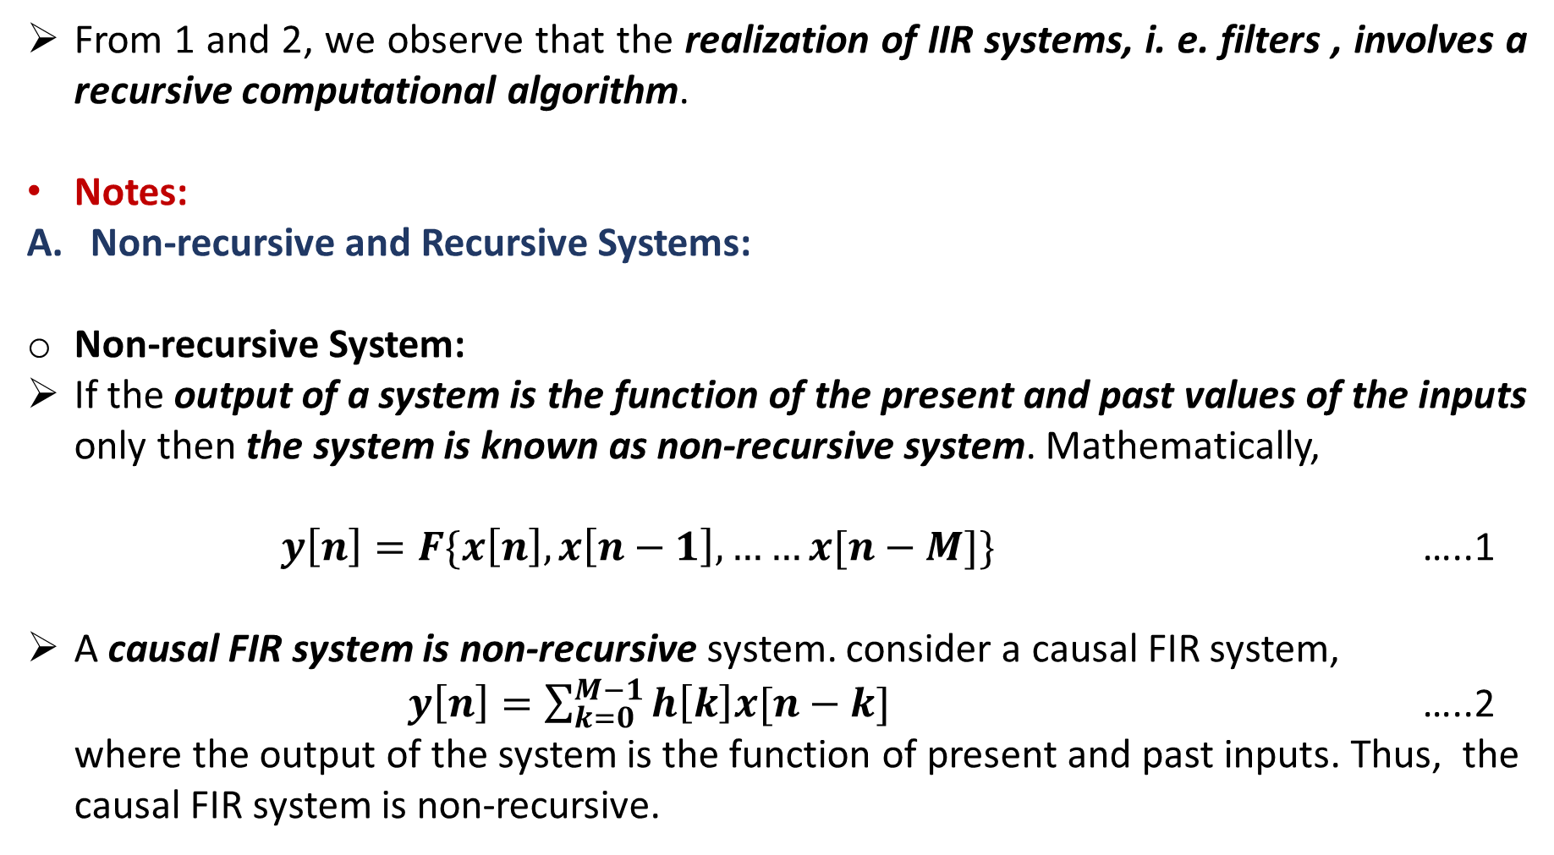
From 1 and 2, we observe that the realization of IIR systems, i. e. filters , involves a recursive computational algorithm.
Notes:
Non-recursive and Recursive Systems:
Non-recursive System:
If the output of a system is the function of the present and past values of the inputs only then the system is known as non-recursive system. Mathematically,
$y\left[n\right]=F\{x\left[n\right],x\left[n−1\right],……x[n−M]\}$ …..1
A causal FIR system is non-recursive system. consider a causal FIR system,
$y\left[n\right]=\sum_{k=0}^{M−1}{h\left[k\right]x[n−k]}$ …..2
where the output of the system is the function of present and past inputs. Thus, the
causal FIR system is non-recursive.

Slide 26
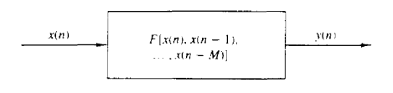
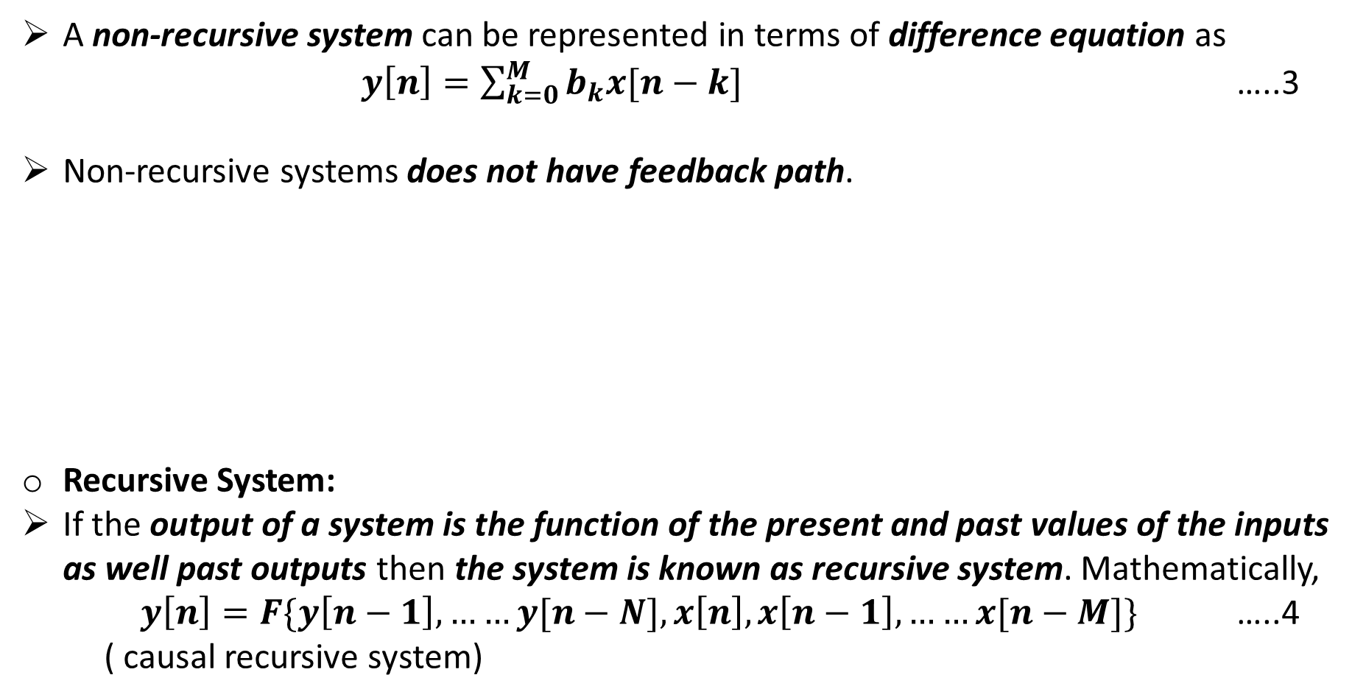
A non-recursive system can be represented in terms of difference equation as
$y\left[n\right]=\sum_{k=0}^{M}{b_{k}x[n−k]}$ …..3
Non-recursive systems does not have feedback path.
Recursive System:
If the output of a system is the function of the present and past values of the inputs as well past outputs then the system is known as recursive system. Mathematically,
$y\left[n\right]=F\{y\left[n−1\right],……y[n−N],x\left[n\right],x\left[n−1\right],……x[n−M]\}$ …..4
( causal recursive system)

Slide 27
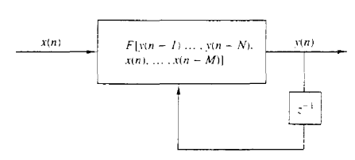
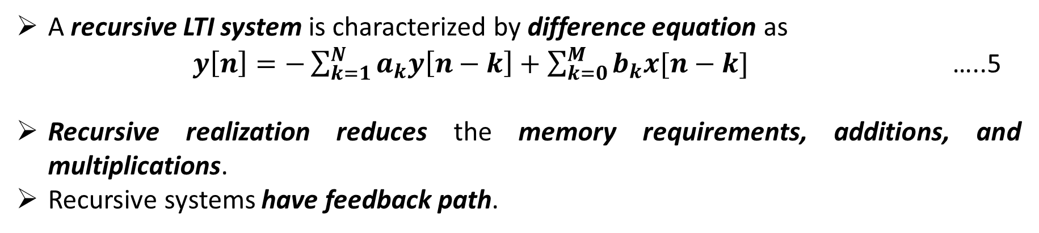
A recursive LTI system is characterized by difference equation as
$y\left[n\right]=−\sum_{k=1}^{N}{a_{k}y\left[n−k\right]+\sum_{k=0}^{M}{b_{k}x[n−k]}}$ …..5
Recursive realization reduces the memory requirements, additions, and multiplications.
Recursive systems have feedback path.

Slide 28
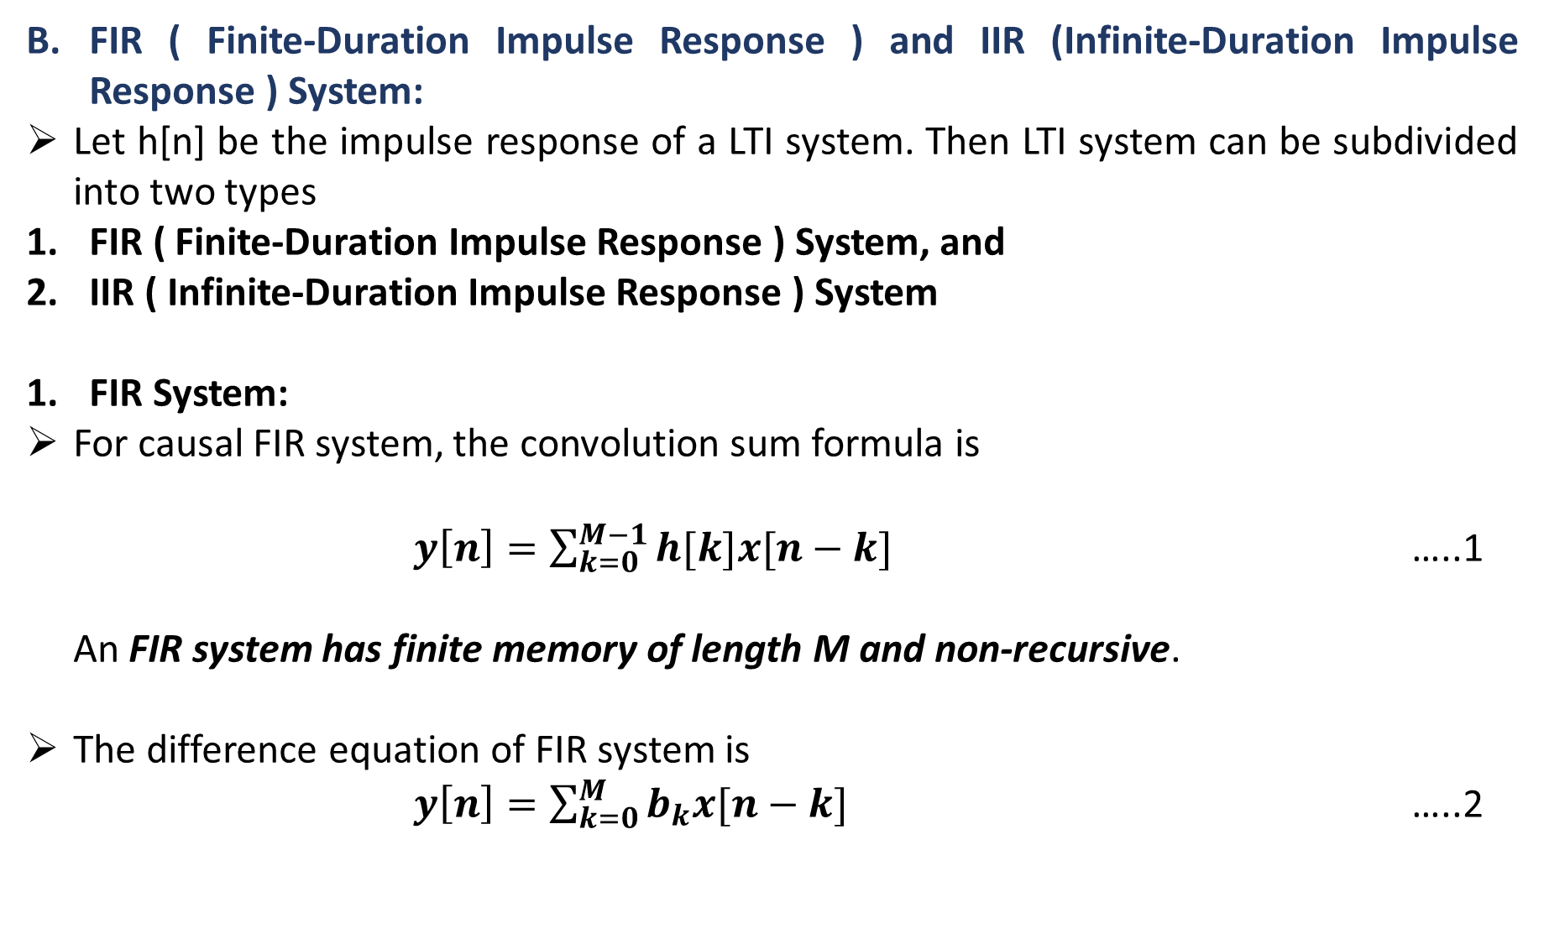
FIR ( Finite-Duration Impulse Response ) and IIR (Infinite-Duration Impulse Response ) System:
Let h[n] be the impulse response of a LTI system. Then LTI system can be subdivided into two types
FIR ( Finite-Duration Impulse Response ) System, and
IIR ( Infinite-Duration Impulse Response ) System
FIR System:
For causal FIR system, the convolution sum formula is
$y\left[n\right]=\sum_{k=0}^{M−1}{h[k]x[n−k]}$ …..1
An FIR system has finite memory of length M and non-recursive.
The difference equation of FIR system is
$y\left[n\right]=\sum_{k=0}^{M}{b_{k}x[n−k]}$ …..2

Slide 29
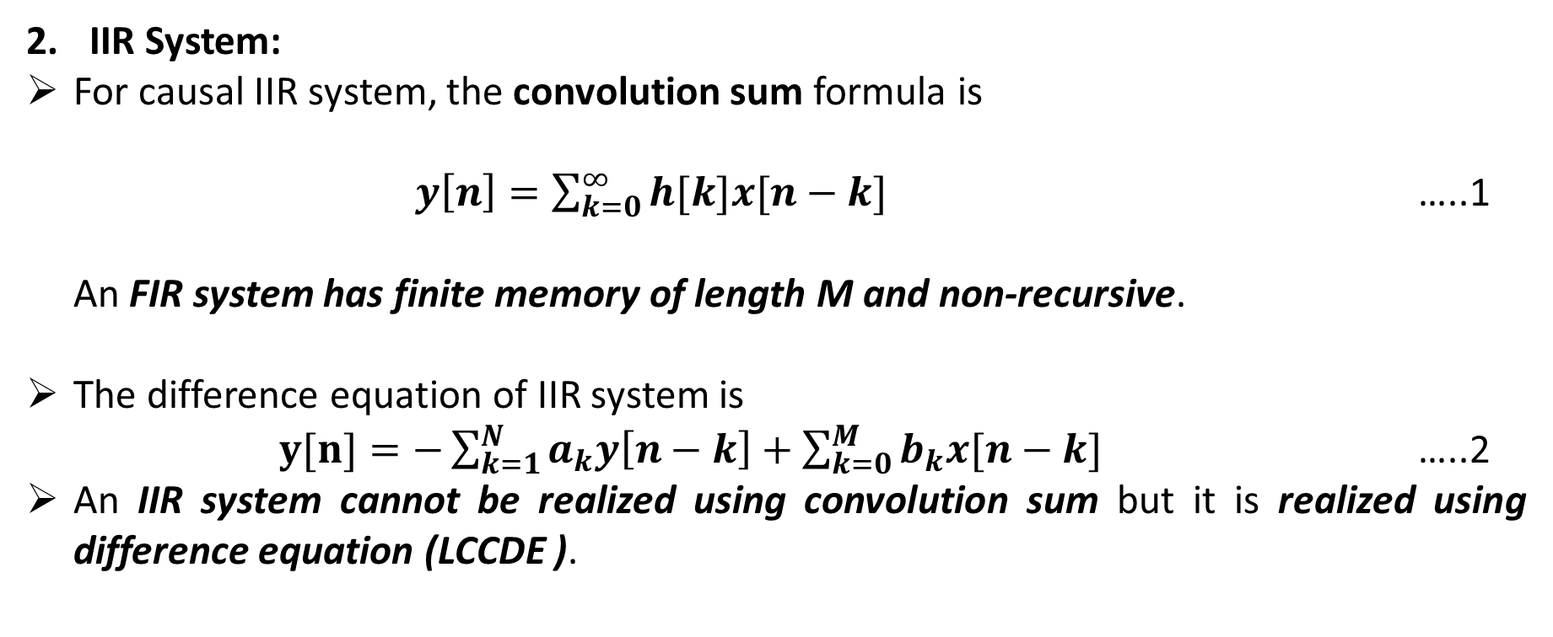
IIR System:
For causal IIR system, the convolution sum formula is
$y\left[n\right]=\sum_{k=0}^{∞}{h[k]x[n−k]}$ …..1
An FIR system has finite memory of length M and non-recursive.
The difference equation of IIR system is
$y[n]=−\sum_{k=1}^{N}{a_{k}y\left[n−k\right]+\sum_{k=0}^{M}{b_{k}x[n−k]}}$ …..2
An IIR system cannot be realized using convolution sum but it is realized using difference equation (LCCDE ).

Slide 30
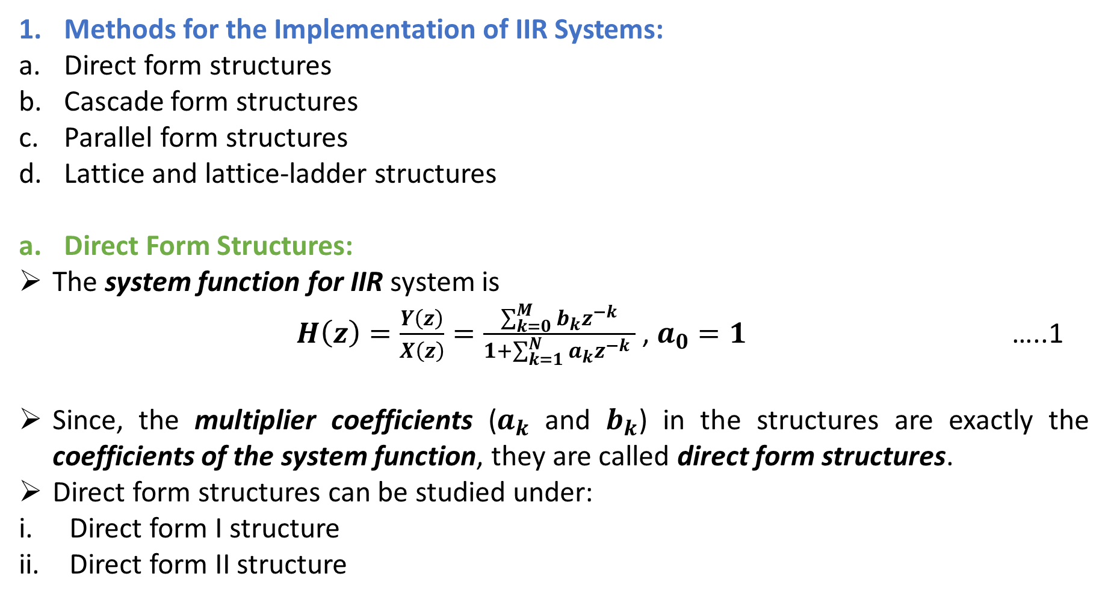
Methods for the Implementation of IIR Systems:
Direct form structures
Cascade form structures
Parallel form structures
Lattice and lattice-ladder structures
Direct Form Structures:
The system function for IIR system is
$H\left(z\right)=\frac{Y\left(z\right)}{X\left(z\right)}=\frac{\sum_{k=0}^{M}{b_{k}z^{−k}}}{1+\sum_{k=1}^{N}{a_{k}z^{−k} }}$ , $a_{0}=1$ …..1
Since, the multiplier coefficients ($a_{k}$ and $b_{k}$) in the structures are exactly the coefficients of the system function, they are called direct form structures.
Direct form structures can be studied under:
Direct form I structure
Direct form II structure

Slide 31
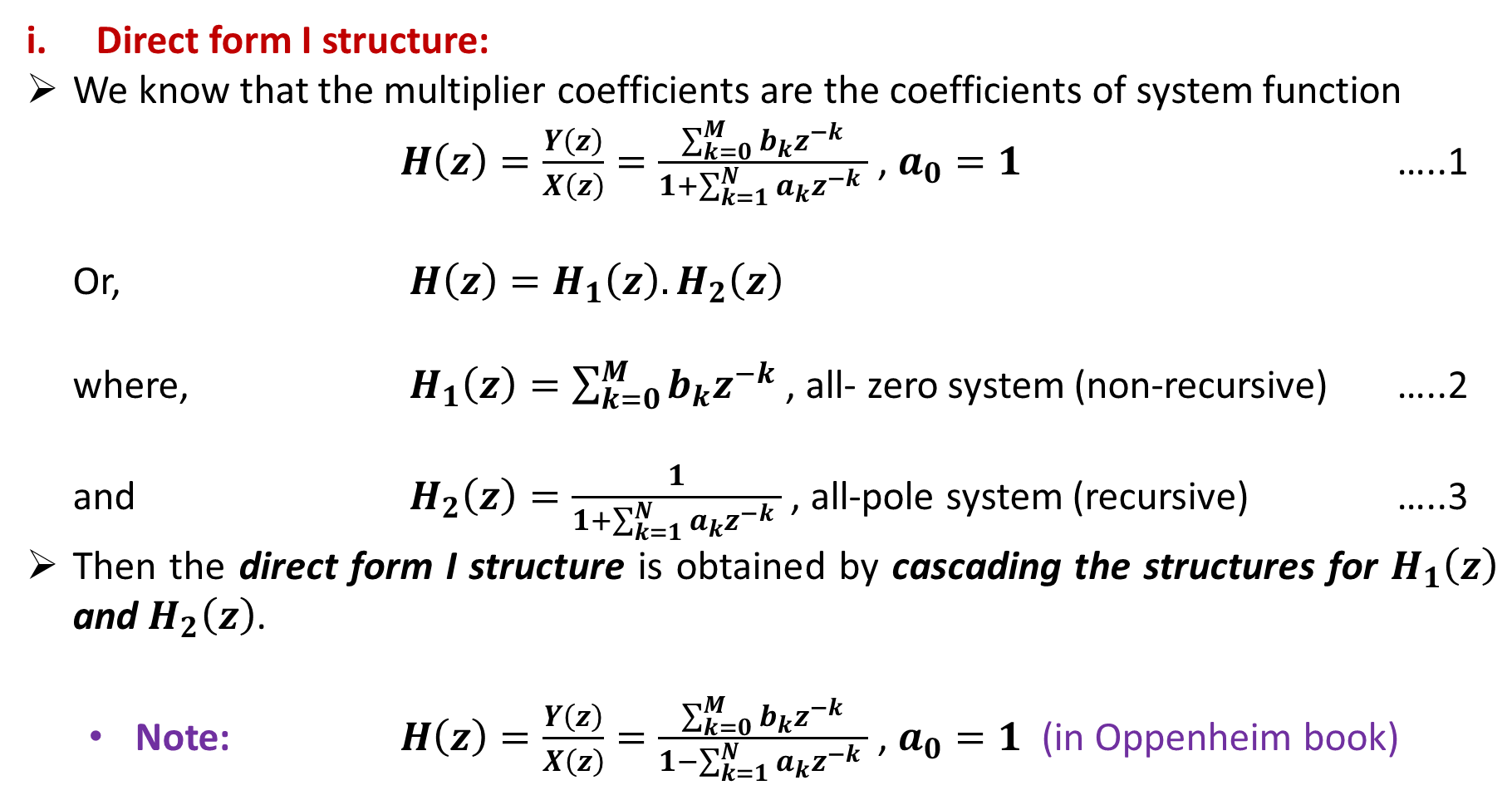
Direct form I structure:
We know that the multiplier coefficients are the coefficients of system function
$H\left(z\right)=\frac{Y\left(z\right)}{X\left(z\right)}=\frac{\sum_{k=0}^{M}{b_{k}z^{−k}}}{1+\sum_{k=1}^{N}{a_{k}z^{−k} }}$ , $a_{0}=1$ …..1
Or, $H\left(z\right)=H_{1}\left(z\right).H_{2}\left(z\right)$
where, $H_{1}\left(z\right)=\sum_{k=0}^{M}{b_{k}z^{−k}}$ , all- zero system (non-recursive) …..2
and $H_{2}\left(z\right)=\frac{1}{1+\sum_{k=1}^{N}{a_{k}z^{−k} }}$ , all-pole system (recursive) …..3
Then the direct form I structure is obtained by cascading the structures for $H_{1}\left(z\right)$ and $H_{2}\left(z\right)$.
Note: $H\left(z\right)=\frac{Y\left(z\right)}{X\left(z\right)}=\frac{\sum_{k=0}^{M}{b_{k}z^{−k}}}{1−\sum_{k=1}^{N}{a_{k}z^{−k} }}$ , $a_{0}=1$ (in Oppenheim book)

Slide 32
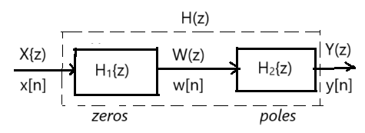
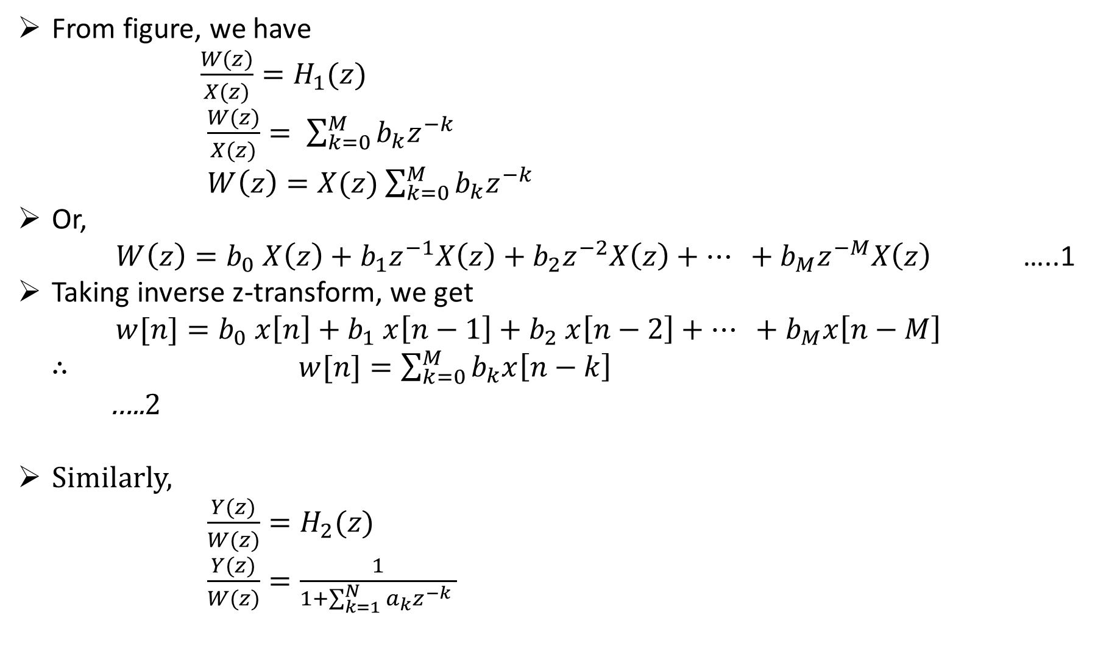
From figure, we have
$\frac{W(z)}{X(z)}=H_{1}(z)$
$\frac{W(z)}{X(z)}= \sum_{k=0}^{M}{b_{k}z^{−k}}$
$W\left(z\right)=X(z)$ $\sum_{k=0}^{M}{b_{k}z^{−k}}$
Or,
$W\left(z\right)=b_{0}$ $X\left(z\right)+b_{1}z^{−1}X\left(z\right)+b_{2}z^{−2}X\left(z\right)+… +b_{M}z^{−M}X\left(z\right)$ …..1
Taking inverse z-transform, we get
$w[n]=b_{0}$ $x\left[n\right]+b_{1} x\left[n−1\right]+b_{2} x\left[n−2\right]+… +$ $b_{M}x\left[n−M\right]$
$∴$ $w[n]=\sum_{k=0}^{M}{b_{k}x\left[n−k\right]}$ …..2
Similarly,
$\frac{Y(z)}{W(z)}=H_{2}(z)$
$\frac{Y(z)}{W(z)}=\frac{1}{1+\sum_{k=1}^{N}{a_{k}z^{−k} }}$

Slide 33
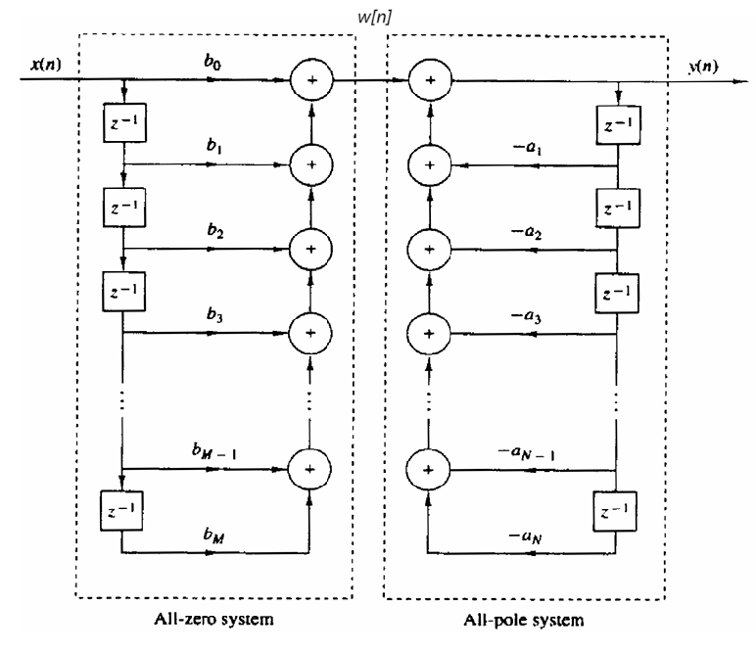
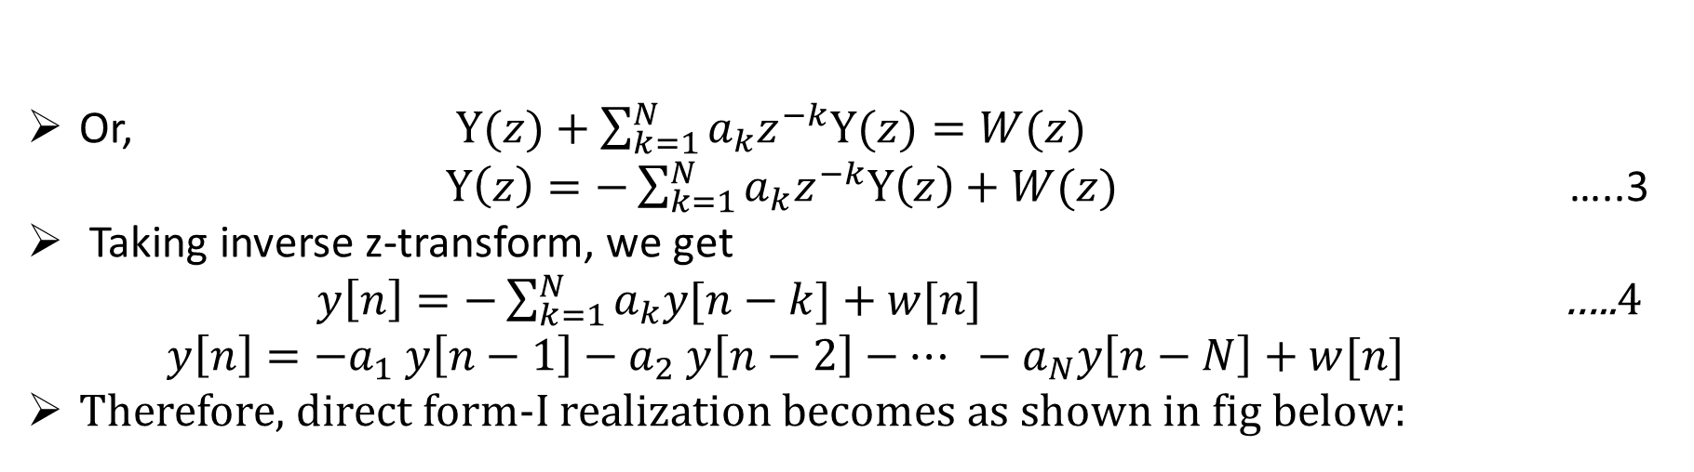
Or, $Y(z)+\sum_{k=1}^{N}{a_{k}z^{−k}Y(z)=W(z)}$
$Y\left(z\right)=−\sum_{k=1}^{N}{a_{k}z^{−k}Y\left(z\right)+W(z)}$ …..3
Taking inverse z-transform, we get
$y\left[n\right]=−\sum_{k=1}^{N}{a_{k}y[n−k]+w[n]}$ …..4
$y\left[n\right]=−a_{1} y\left[n−1\right]−a_{2} y\left[n−2\right]−… −$ $a_{N}y\left[n−N\right]+w[n]$
Therefore, direct form-I realization becomes as shown in fig below:

Slide 34
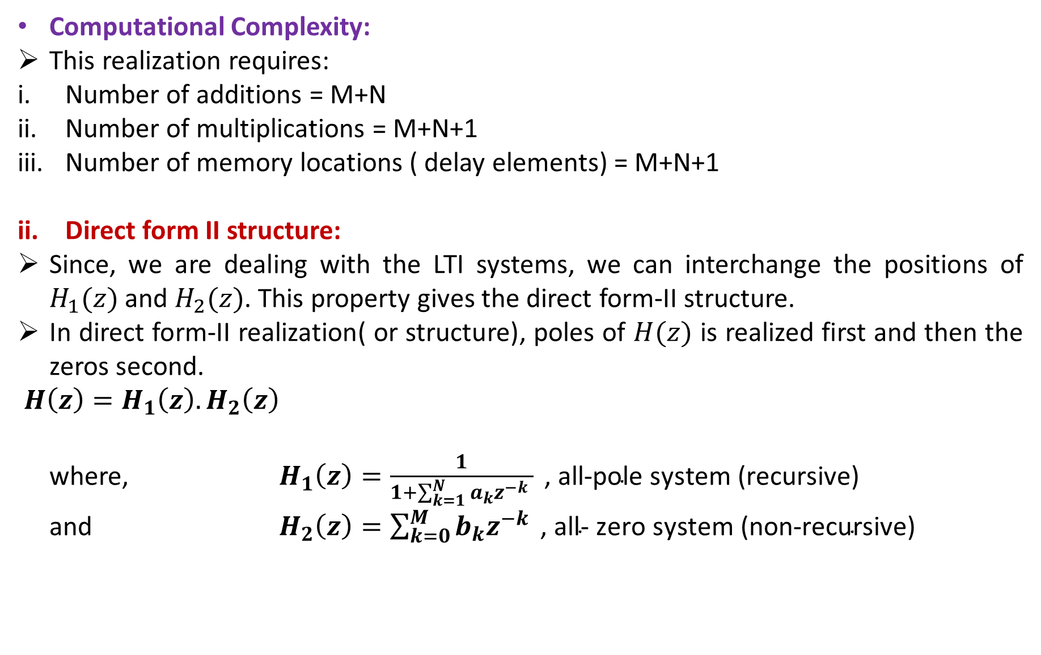
Computational Complexity:
This realization requires:
Number of additions = M+N
Number of multiplications = M+N+1
Number of memory locations ( delay elements) = M+N+1
Direct form II structure:
Since, we are dealing with the LTI systems, we can interchange the positions of $H_{1}(z)$ and $H_{2}(z)$. This property gives the direct form-II structure.
In direct form-II realization( or structure), poles of $H(z)$ is realized first and then the zeros second.
$H\left(z\right)=H_{1}\left(z\right).H_{2}\left(z\right)$
where, $H_{1}\left(z\right)=\frac{1}{1+\sum_{k=1}^{N}{a_{k}z^{−k} }}\text{ , }\text{all}\text{−}\text{pole} \text{system}\text{ (}\text{recursive}\text{)}$
and $H_{2}\left(z\right)=\sum_{k=0}^{M}{b_{k}z^{−k}}\text{ , }\text{all}\text{−} \text{zero} \text{system}\text{ (}\text{non}\text{−}\text{recursive}\text{)}$

Slide 35
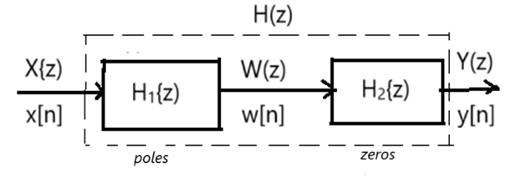
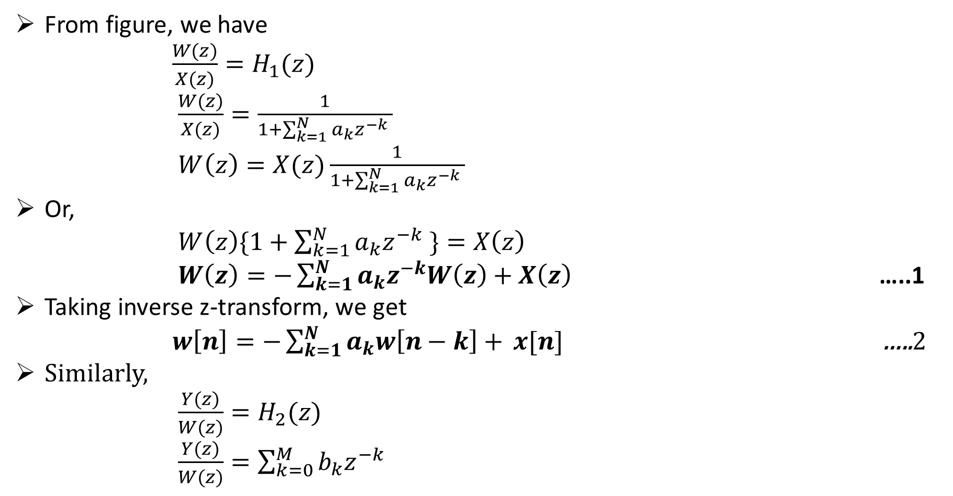
From figure, we have
$\frac{W(z)}{X(z)}=H_{1}(z)$
$\frac{W(z)}{X(z)}=\frac{1}{1+\sum_{k=1}^{N}{a_{k}z^{−k} }}$
$W\left(z\right)=X(z)\frac{1}{1+\sum_{k=1}^{N}{a_{k}z^{−k} }}$
Or,
$W\left(z\right)\{1+\sum_{k=1}^{N}{a_{k}z^{−k} \}}=X\left(z\right)$
$W\left(z\right)=−\sum_{k=1}^{N}{a_{k}z^{−k}W\left(z\right)+X\left(z\right) }$ …..1
Taking inverse z-transform, we get
$w\left[n\right]=−\sum_{k=1}^{N}{a_{k}w\left[n−k\right]+ }x[n]$ …..2
Similarly,
$\frac{Y(z)}{W(z)}=H_{2}(z)$
$\frac{Y(z)}{W(z)}=\sum_{k=0}^{M}{b_{k}z^{−k}}$

Slide 36
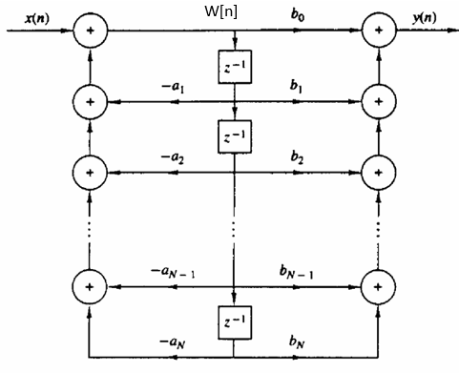
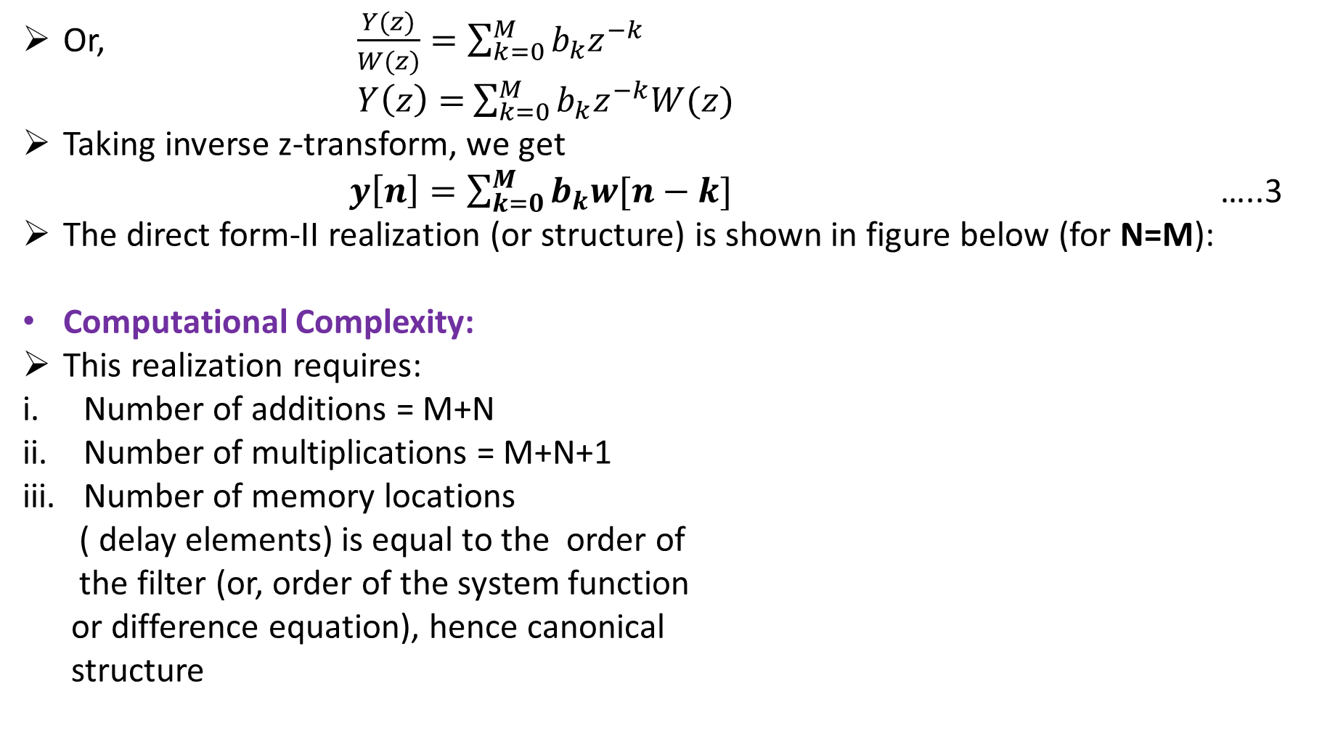
Or, $\frac{Y(z)}{W(z)}=\sum_{k=0}^{M}{b_{k}z^{−k}}$
$Y\left(z\right)=$ $\sum_{k=0}^{M}{b_{k}z^{−k}W(z)}$
Taking inverse z-transform, we get
$y\left[n\right]=\sum_{k=0}^{M}{b_{k}w[n−k]}$ …..3
The direct form-II realization (or structure) is shown in figure below (for N=M):
Computational Complexity:
This realization requires:
Number of additions = M+N
Number of multiplications = M+N+1
Number of memory locations
( delay elements) is equal to the order of
the filter (or, order of the system function
or difference equation), hence canonical
structure

Slide 37


Cascade Form Structures:
The cascade form realization of an IIR system or filter is obtained by decomposing the system function $H\left(z\right)$ into a product of simpler transfer functions as:
$H\left(z\right)=AH_{1}\left(z\right)H_{2}\left(z\right)……H_{K}(z)$
$H\left(z\right)=A\prod_{k=1}^{K}{H_{k}(z)}$ …..1
where, $A=$a constant
$k=$ integer part of $\frac{N+1}{2}$
and it is assumed that $M≤N$

Slide 38


Parallel Form Structures:
By $using partial fractionn epansion, the overall$system function $H\left(z\right)$can be expressed as:
$H\left(z\right)=C+H_{1}\left(z\right)+H_{2}\left(z\right)+……{+H}_{K}(z)$ …..1
where, $C=$ a constant
$H_{1}\left(z\right),H_{2}\left(z\right),……{,H}_{K}\left(z\right)=$ second order sub-systems
and, $H\left(z\right)=\frac{Y\left(z\right)}{X\left(z\right)}=\frac{\sum_{k=0}^{M}{b_{k}z^{−k}}}{1+\sum_{k=1}^{N}{a_{k}z^{−k} }}$ , $a_{0}=0$
Application:
For high-speed filtering. Because the processing
of filtering operation is performed parallelly.

Slide 39


Lattice and Lattice-ladder Structure:
Lattice filters are used in digital speech processing and the implementing of adaptive filters.
Lattice Structure:
An all-pole system with system function
…..1
and the difference equation is
$y\left[n\right]=−\sum_{k=1}^{N}{a_{N}\left(k\right) y\left[n−k\right]+x[n]}$ …..2
Or, $x\left[n\right]=y\left[n\right]+\sum_{k=1}^{N}{a_{N}\left(k\right) y\left[n−k\right]}$ …..3
For $N=1$:
We have, $x\left[n\right]=y\left[n\right]+a_{1}\left(1\right) y\left[n−1\right]$ $∵N=k=1$
$y\left[n\right]=x\left[n\right]−a_{1}\left(1\right) y\left[n−1\right]$ …..4

Slide 40


We have, $x\left[n\right]=y\left[n\right]+a_{1}\left(1\right) y\left[n−1\right]$ $∵N=k=1$
$y\left[n\right]=x\left[n\right]−a_{1}\left(1\right) y\left[n−1\right]$ …..4
From figure, we have
$x\left[n\right]=f_{1}[n]$
$y\left[n\right]=f_{0}\left[n\right]=f_{1}\left[n\right]−k_{1}g_{0}[n−1]$
Or, $y\left[n\right]=x\left[n\right]−k_{1}y[n−1]$ …..5
Also, $g_{1}\left[n\right]=k_{1}y\left[n\right]+y[n−1]$
From equations (4) and (5), we know
$k_{1}=a_{1}\left(1\right)$ …..6
For $N=2$:
We have, $x\left[n\right]=y\left[n\right]+a_{2}\left(1\right) y\left[n−1\right]+a_{2}\left(2\right) y\left[n−2\right]$ $∵N=k=1$
$y\left[n\right]=x\left[n\right]−a_{2}\left(1\right) y\left[n−1\right]−a_{2}\left(2\right) y\left[n−2\right]$ …..7
This output can be achieved from two-stage lattice structure as shown in figure below:

Slide 41


From figure, we have
$x\left[n\right]=f_{2}[n]$
$f_{1}\left[n\right]=f_{2}\left[n\right]−$ $k_{2}g_{1}[n−1]$
$g_{2}\left[n\right]=k_{2}f_{1}\left[n\right]+k_{2}g_{1}[n−1]$
$f_{0}\left[n\right]=f_{1}\left[n\right]−k_{1}g_{0}[n−1]$
$g_{1}\left[n\right]=k_{1}f_{0}\left[n\right]+g_{0}[n−1]$
Therefore,
$y\left[n\right]=f_{0}\left[n\right]=g_{0}\left[n\right]$
$y\left[n\right]=f_{1}\left[n\right]−k_{1}g_{0}[n−1]$
$y\left[n\right]=\left\{f_{2}\left[n\right]− k_{2}g_{1}\left[n−1\right]\right\}−k_{1}g_{0}[n−1]$
$y\left[n\right]=f_{2}\left[n\right]−k_{2}\{k_{1}f_{0}\left[n−1\right]+g_{0}[n−2]\}−k_{1}g_{0}[n−1]$
$y\left[n\right]=f_{2}\left[n\right]−k_{2}k_{1}f_{0}\left[n−1\right]−k_{2}g_{0}[n−2]−k_{1}g_{0}[n−1]$
$y\left[n\right]=x\left[n\right]−k_{2}k_{1}y\left[n−1\right]−k_{2}y[n−2]−k_{1}y[n−1]$
Therefore, $y\left[n\right]=x\left[n\right]−k_{1}(1+k_{2})y\left[n−1\right]−k_{2}y[n−2]$ …..8

Slide 42


In similar manner, we obtain
$g_{2}\left[n\right]=k_{2}y\left[n\right]+k_{1}\left(1+k_{2}\right)y\left[n−1\right]+y[n−1]$ …..9
From equations (7) and (8), we have
$a_{2}\left(0\right)=1$
$a_{2}\left(1\right)=k_{1}(1+k_{2})$
and, $k_{1}(1+k_{2})$
$a_{2}\left(2\right)=k_{2}$
Therefore, N-stage lattice structure of IIR filter is obtained as shown in figure below:

Slide 43


From figure, we have
$f_{N}[n]=x[n]$
$f_{m−1}\left[n\right]=f_{m}\left[n\right]−k_{m}g_{m−1}\left[n−1\right]$, $m=N,N−1,….,1$
$g_{m}\left[n\right]=k_{m}f_{m−1}\left[n\right]+g_{m−1}\left[n−1\right]$, $m=N,N−1,….,1$
$y\left[n\right]=f_{0}\left[n\right]=g_{0}\left[n\right]$
Lattice-ladder Structure:
A general IIR filter connecting both poles and zeros can be realized ( or implemented) using all-pole lattice as building block. To develop appropriate structure, let us consider an IIR system with system function:
…..1
where, $N≥M$

Slide 44


The lattice structure for equation (1) is constructed first by realizing all-pole lattice coefficients $k_{m}$ , where, $1≤m≤N$ for the denominator $A_{N}(z)$, and then adding the ladder part by taking the output as a weighted linear combination of $g_{m}[m]$.
The result is the pole-zero IIR (lattice-ladder) structure.
The lattice-ladder structure for $M=N$ is shown in figure below:

Slide 45


The output is given by
…..2
where, $v_{m}=$ ladder coefficients and obtained by the equation
$v_{m}=c_{m}−\sum_{i=1+m}^{M}{v_{i}a_{i}(i−m)}$, $m=M, M−1,….0$ …..3
Conversion from Lattice Structure to Direct-form Structure:
In general,
$a_{m}\left(0\right)=1$
$a_{m}\left(m\right)=k_{m}$
$a_{m}\left(k\right)=a_{m−1}\left(k\right)+a_{m}\left(m\right)$ $a_{m−1}\left(m−k\right)$

Slide 46

Conversion of Direct Form Coefficients to Lattice Coefficients :
In general,
$a_{m}\left(0\right)=1$
$k_{m}=a_{m}\left(m\right)$
$a_{m−1}\left(k\right)=\frac{a_{m}\left(k\right)−a_{m}\left(m\right)a_{m}\left(m−k\right)}{1−{{\{a}_{m}(m)\}}^{2}}$

Slide 47
Quantization Effect (Truncation and Rounding):

